Slide 1

Extending RISC-V Keystone to Include Efficient Secure Memory
Zach Moolman
Tamara Silbergleit Lehman
Electrical, Computer & Energy Engineering
College of Engineering and Applied Science
Notes:
Hello everyone, I am Zach Moolman and I am a Ph.D. student at University of Colorado, Boulder. Tamara Lehman is my my advisor. She is also a co-author on this workshop paper. I am excited to present to you our work and to show you how we are using RISC-V in our work and how we are contribution to the RISC-V community/space.
? I think it would have been much harder to work in computer architecture in general without RISC-V and all the resource available to conduct our research.
My talk today is about how we can extend RISC-V and Keystone to include Secure Memory Efficiently
One of our key objectives for this work is to use FPGAs to build our prototype and to finally conduct our analysis . (If I only knew what I am getting myself into)

Slide 2
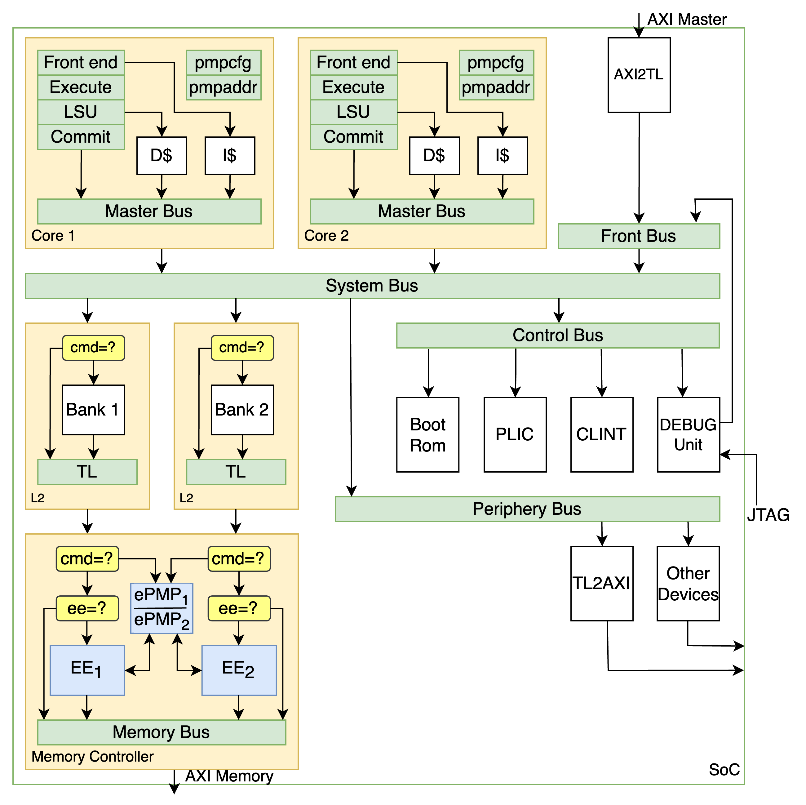
Why are we here?
To build micro-architecture systems where security is a first-class citizen.
Secure Memory in Hardware
Notes:
Why are we here and I am not referring to why are we here on planet earth but
We want to build micro-architecture system where security is a first-class citizen.
But first I will you some background information on why do we care and our motivation ABD we are ddoing it in hardware!!

Slide 3
GHOST
Background
Multi discipline project
NSF funded
One of GHOST's goals is to operate securely through public 5G network
Notes:
Ghost
5G Hidden Operations through Securing Traffic (GHOST)
GHOST Is a multi discipline project funded by NSF.
The object of GHOST is to enable organizations to securely operate through public 5G networks while meeting security and resilience requirements.

Slide 4
GHOST
The problem
Using network – exposing your activities
Data are encrypted – information can be derived
Network controlled by adversary
Notes:
Problem
- The problem is that, simply by using a 5G network, you are exposing your activities through the network.
Even though 5G data packets are encrypted – a lot information can be derived from network activity/meta data.
5G network might be an adversary network.
Besides revealing group activity, an individual network traffic can also reveal a pattern of life that can lead identification of a specific target. This is a sample of the websites accesses by all the team members in the last 24hrs prior to doing the exercise. You can see here that very few columns are shared, and very clear patterns emerge.

Slide 5
GHOST
Features
Activity shaping
Sim swapping
Notes:
GHOST have many features. Today I will show two features.

Slide 6
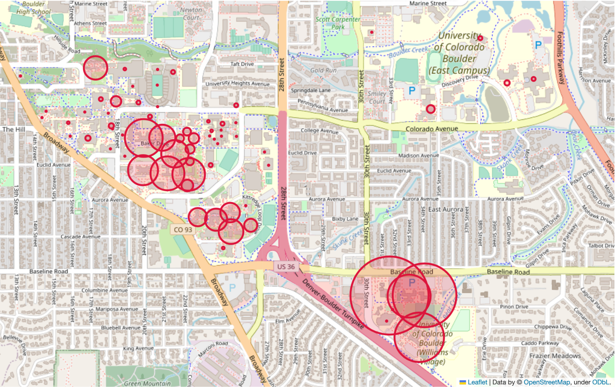
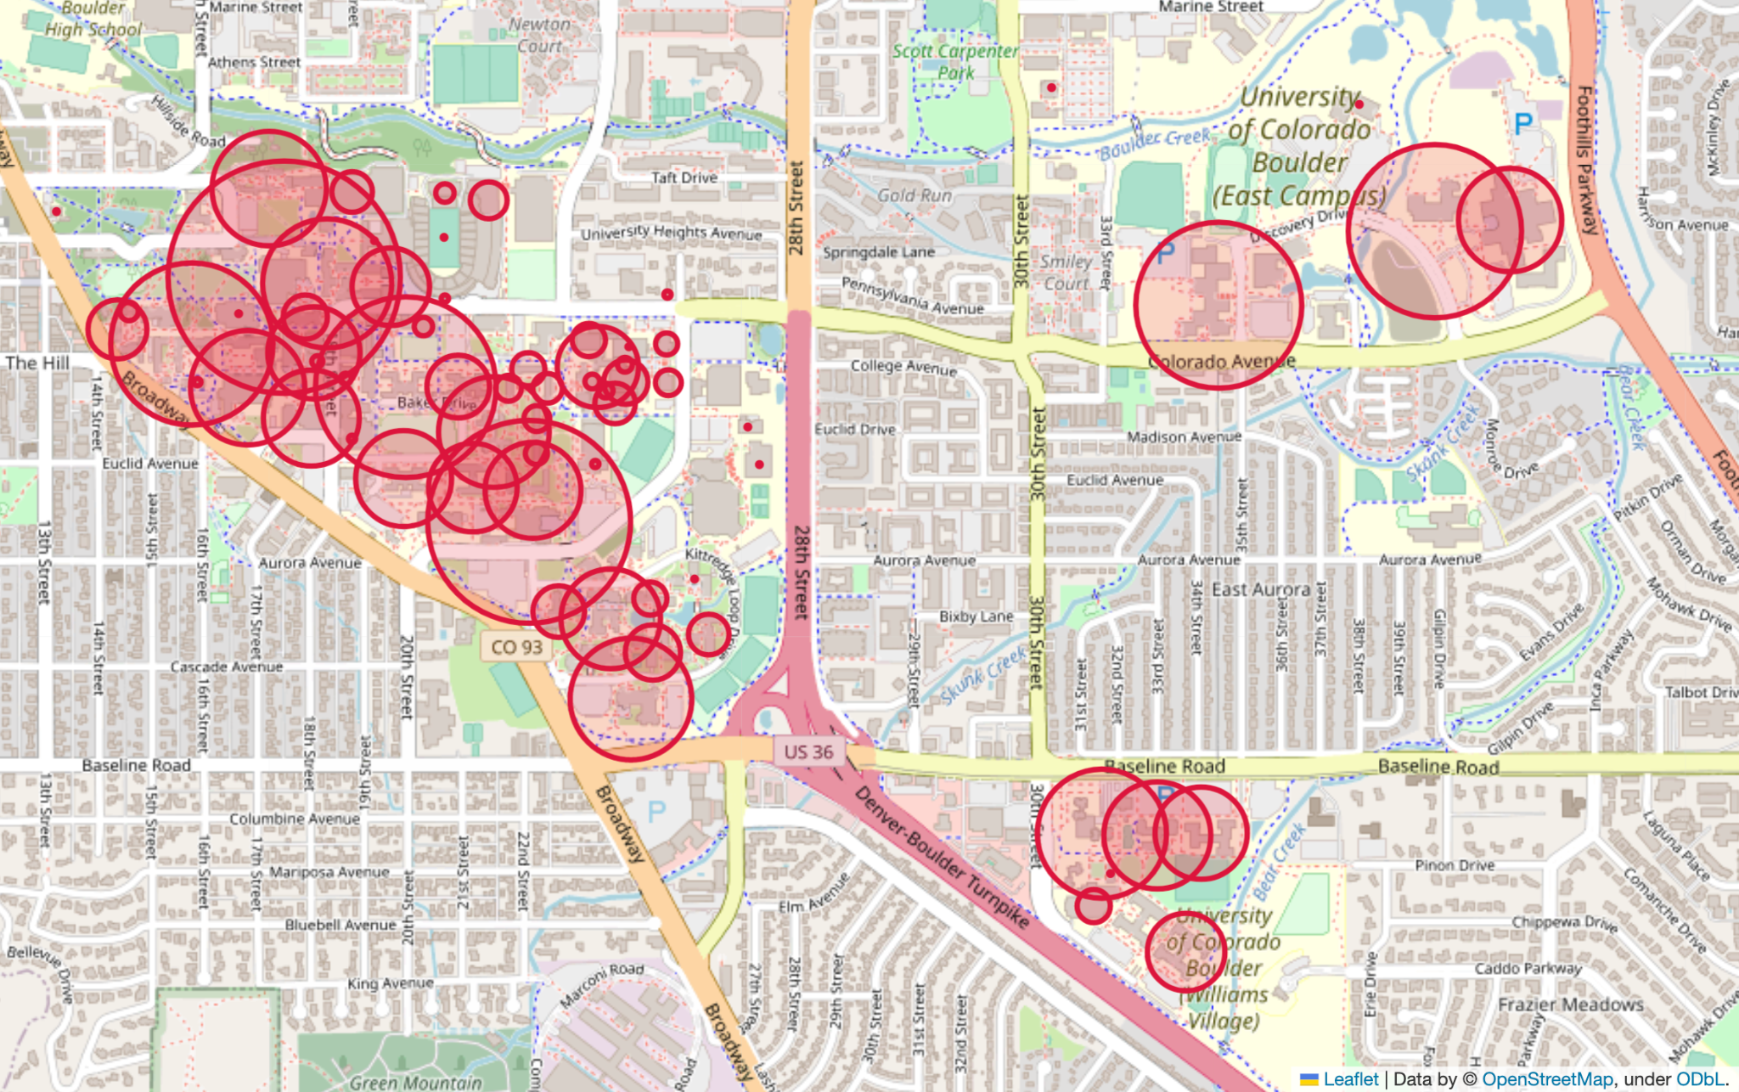
GHOST
Exposing your activities
Network device count at 6:58 am
Network device count at 12:40 pm
Tschimben, S., Bates, I., Curry, J. H., Gremban, K. D., & Siegel, A. (2023, October). Modeling and Generation of Realistic Network Activity. In MILCOM 2023-2023 IEEE Military Communications Conference (MILCOM) (pp. 761-766). IEEE.
Notes:
------ NOT USED
Group activity can reveal organizational operations and structure. For example, in the images here, circle size represents the number of devices active in buildings. You can see activity moving from lower right in the morning, to upper left and upper right at mid-day. This data is from CU Wi-Fi, courtesy of OIT, and represents campus network activity. What if, instead, this represented the activity of US personnel in a foreign country? The bad guys would know where and when to attack, or where to infiltrate.
Besides revealing group activity, an individual network traffic can also reveal a pattern of life that can lead identification of a specific target. This is a sample of the websites accesses by all the team members in the last 24hrs prior to doing the exercise. You can see here that very few columns are shared, and very clear patterns emerge.

Slide 7
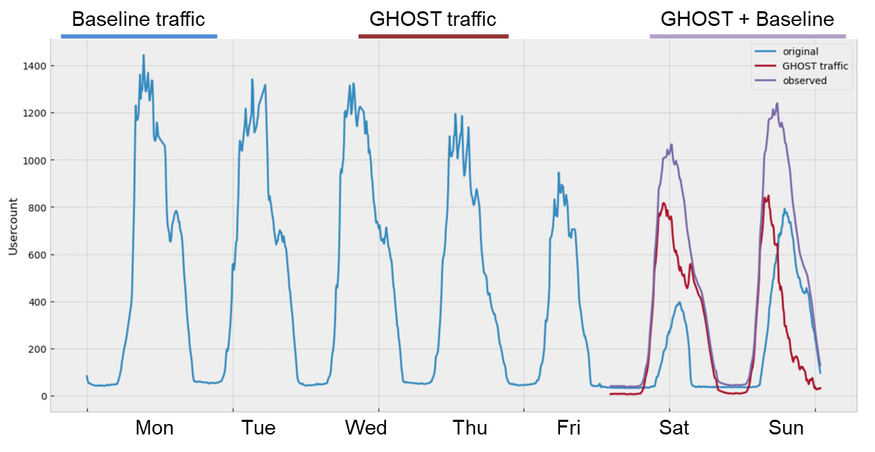
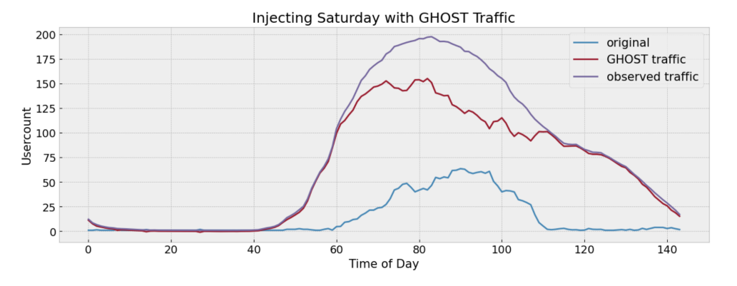
GHOST
Hiding in Plain Sight
Weekend network activity look like weekday activity
NMF model changes the observed pattern of network activity
Tschimben, S., Bates, I., Curry, J. H., Gremban, K. D., & Siegel, A. (2023, October). Modeling and Generation of Realistic Network Activity. In MILCOM 2023-2023 IEEE Military Communications Conference (MILCOM) (pp. 761-766). IEEE.
Notes:
Figure 1 Injecting GHOST traffic makes weekend network activity look like weekday activity
Fig. 2: Injecting GHOST traffic developed from an NMF model changes the observed pattern of network activity.
GHOST looks to solve this problem by obfuscating the patterns, both for groups of users and individuals. With GHOST software, a powerful network observer would not be able to discern the difference between two different users, neither based on their individual activity patterns nor their group activity.

Slide 8

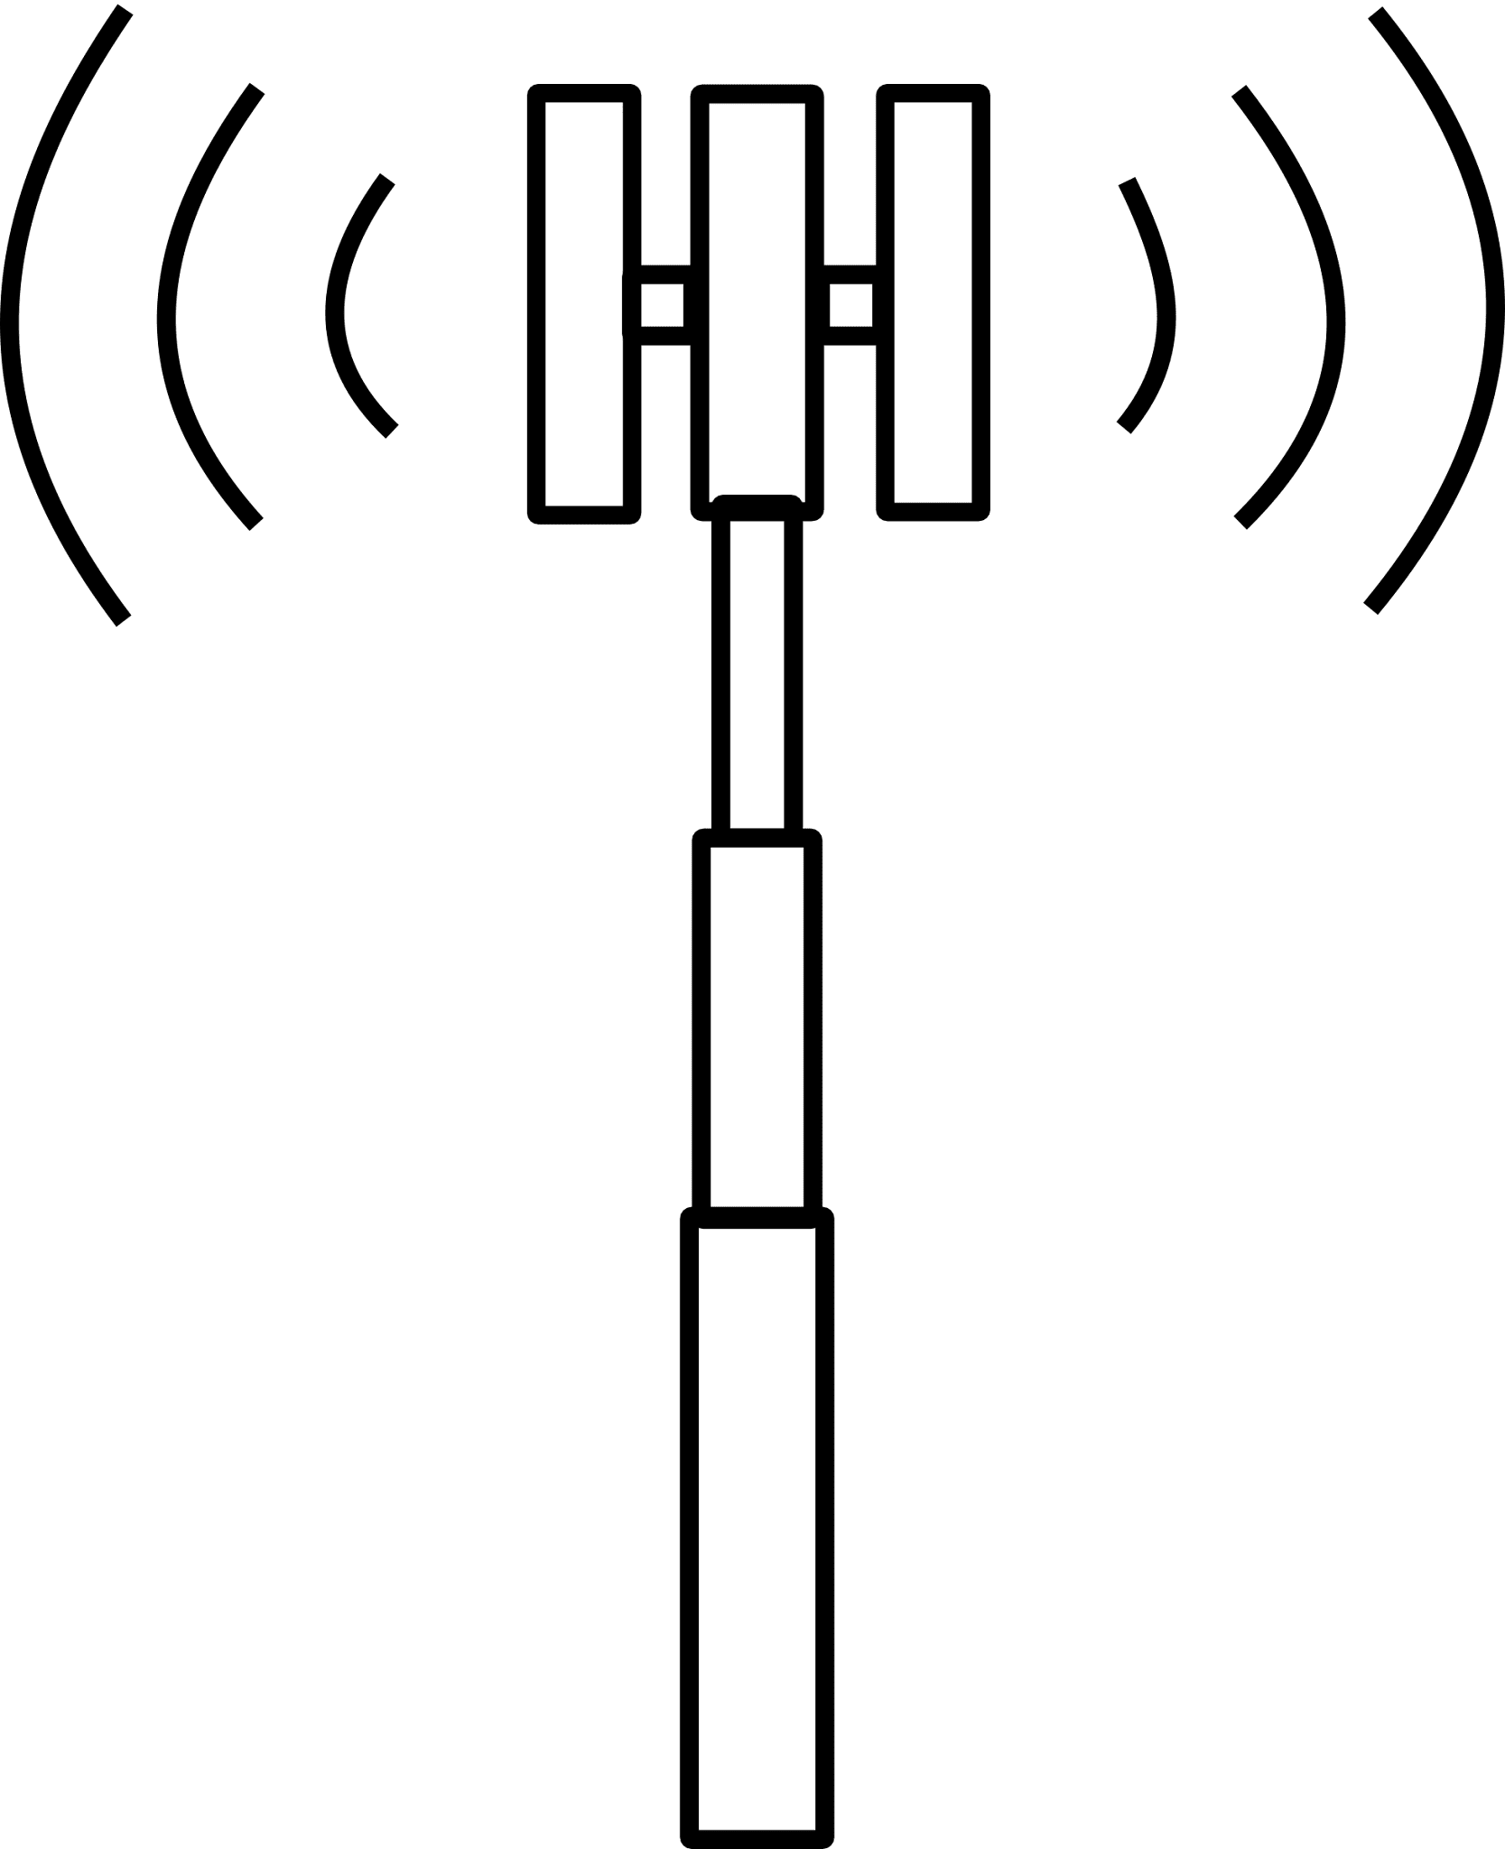



GHOST
SIM_{A}
SIM_{B}
Alice
Bob
Sim Swapping
Normal behavior
Observer
SIM_{A}
SIM_{B}
Alice
Bob
Notes:
GHOST have many features such as Sim swapping, Personnas, Injection
Here I only illustrate one feature
----- NOT USED
U.S. organizations wish to use indigenous 5G networks when operating in other countries
BUT
The 5G network may be operated by a hostile entity
Assume all network activity is observed

Slide 9
GHOST
Alice
Bob
SIM_{A}
SIM_{B}
Sim Swapping
Normal behavior
Observer
GHOST Enabled
Observer
SIM_{A}
SIM_{B}
Alice
Bob
Notes:
GHOST have many features such as Sim swapping, Personnas, Injection
Here I only illustrate one feature
----- NOT USED
U.S. organizations wish to use indigenous 5G networks when operating in other countries
BUT
The 5G network may be operated by a hostile entity
Assume all network activity is observed

Slide 10

GHOST
Device Security
Stolen
Remotely Access
Require additional security
Isolation (TEE)
Confidentiality and Integrity (Encryption)
Notes:
---- not used
Given that GHOST runs on mobile devices, there is another threat: devices can be stolen or remotely accessed
Provide an additional isolation level from both common and privileged software by running GHOST software in a Trusted Execution Environment (TEE)
Leverage device level authentication and attestation
Enable confidentiality and integrity verification of data and code in memory

Slide 11
Extending RISC-V Keystone To Include Efficient Secure Memory
Trusted Execution Environments (TEEs)
What is a TEE?
Isolation
Privileged Software (OS)
Attestation Hardware & Software
Trust Chip/SoC Boundary
Commercial TEEs
Intel SGX – Large TCB
Arm TrustZone – Two Worlds
Notes:
What is an TEE?
SGX (intel), TrustZone (ARM), (AMD) – xepand on each and conclude with “they are all proprietary framework and there isn’t that adjustable and flexible site SXG paper “
To enhance the security guarantees of a system that does not trusts the privilege software (such as the operating system), a trusted execution environment can be in place.
In general, only the chip boundary is trusted, and security features are built around this concept.
Applications developed for the TEE, need to have a restricted interface with the unsecure world. Strict software practices are recommended for passing data in and out of the trusted boundary.
In addition, we want to make sure that the code running on the TEE is not modified by a malicious user.
TEE typically provide a way to authenticate the software to be run by signing it with a private key to verify its origin.
Most TEEs also offer a way to attest the code by hashing the binary to verify that it was not tampered with before it executes.
This is a well-established computing model today and even has mobile applications given that ARM has had Trustzone since early 2000’s

Slide 12
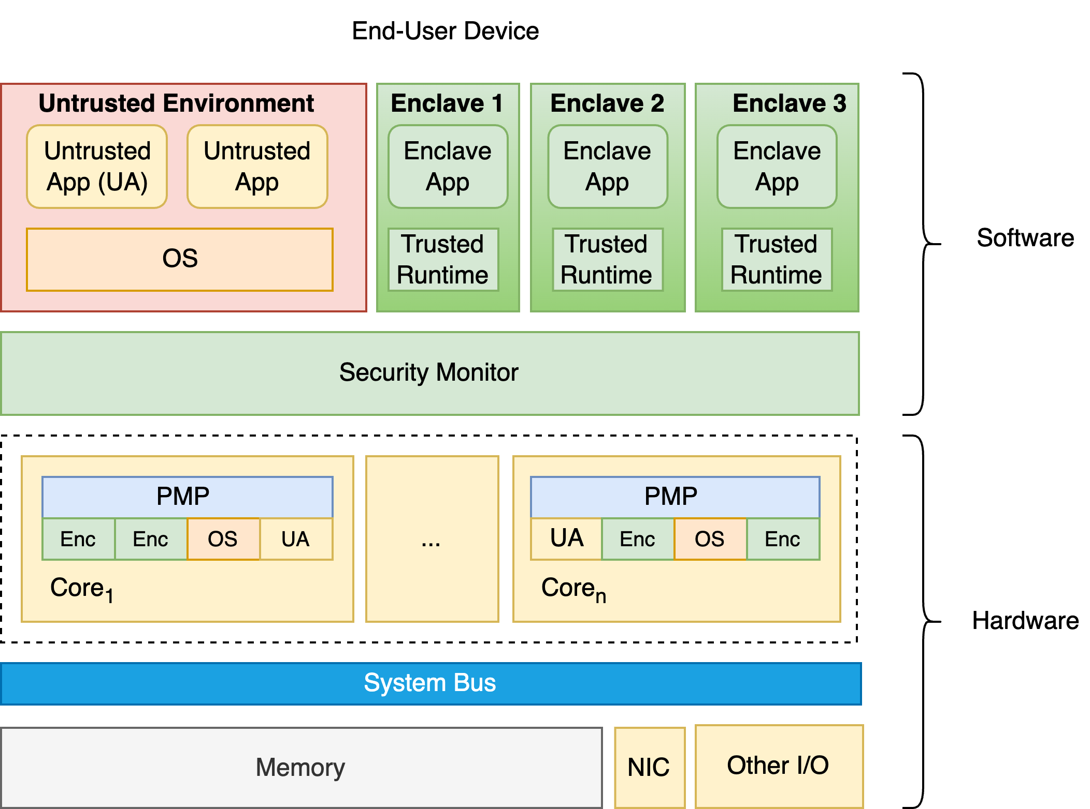
Extending RISC-V Keystone To Include Efficient Secure Memory
Keystone
Dayeol Lee
Thread Model
Open Source
Custom TEE
Lee, D., Kohlbrenner, D., Shinde, S., Asanović, K., and Song, D. Keystone: Anopen framework for architecting trusted execution environments. In Proceedings of the Fifteenth European Conference on Computer Systems (2020), pp. 1–16.
Notes:
- Keystone is a tee design by Dayeol Lee as part of his dissertation at Berkeley. Keystone main contribution is to was to desgin a TEE that give as that not only give you the desired properties of TEE but also allows you greater flexibles than other TEE implementations.

Slide 13
Extending RISC-V Keystone To Include Efficient Secure Memory
RISC-V
Privileged Levels
User
Supervisory
Reserved (Hypervisor)
Machine
Control Status Registers (CSR)
Physical Memory Protection (PMP)
Notes:
--- TAMARA
Keystone defines three operating modes
User mode: all applications run in this mode, least privilege
Supervisor mode: operating system and runtime environments inside the TEE
Machine mode: Highest privilege mode, manages access permission, context switches, interactions across environments and attestation
Machine mode manages the memory access permissions through the Physical Memory Protections (PMP)

Slide 14
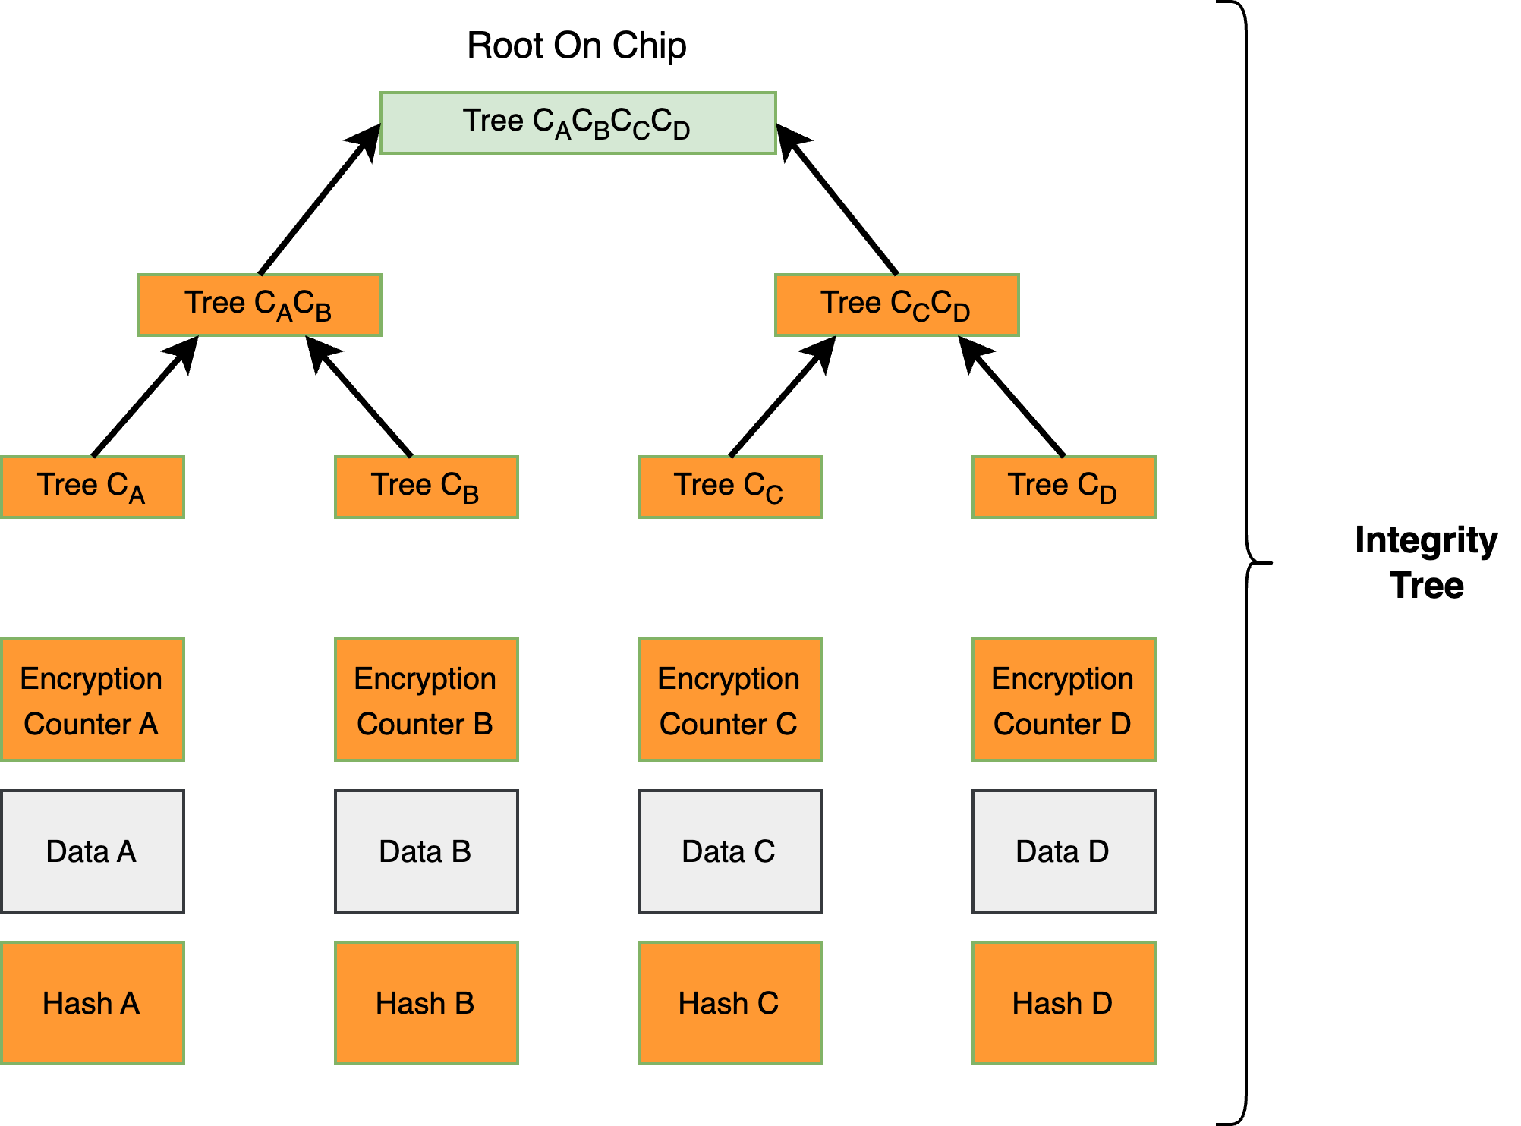
Extending RISC-V Keystone Include Efficient Secure Memory
Secure Memory
Isolation is not enough
Confidentiality
Protect sensitive data
Counter-mode encryption
Encryption is parallelized with data requests
Data integrity
Active attacks
Bonsai Merkle trees
Rogers, B., Chhabra, S., Prvulovic, M., and Solihin, Y. Using address inde-pendent seed encryption and Bonsai Merkle trees to make secure processors
OS- and performance-friendly. In International Symposium on Microarchitecture(MICRO) (2007)
Notes:
TEE, give us isolation and protection from within the closed system. However ,we also need to prevent physical and remote attacked.
it prevents sensitive data from being disclosed.
Data Integrity
Confidentiality, its great but Confidentiality does not protect against by rely attacks and changing memory to change the behavior of the program.
The BMT establishes the root of trust by storing the root of the tree always on chip. When a piece
of data is fetched from memory, the tree is traversed from leaves to
the root, comparing hashes along the way, to verify the integrity
of the data.
--- TAMARA
Besides using the TEE, the GHOST device needs to also support secure memory features in order to prevent physical and remote memory attacks.
To detect and prevent physical attacks, data in memory should have confidentiality. An attacker should not be able to read the values that are crossing the communication bus between the processor and the memory. And that is what confidentiality does, it prevents sensitive data from being disclosed.
But confidentiality alone does not prevent an active attack, in which the attacker modifies the values in memory to control the behavior of the program. And for that, a secure system should also provide data integrity, the property that ensures that no data is modified in an unauthorized way.

Slide 15
Extending RISC-V Keystone To Include Efficient Secure Memory
Our Work

Slide 16
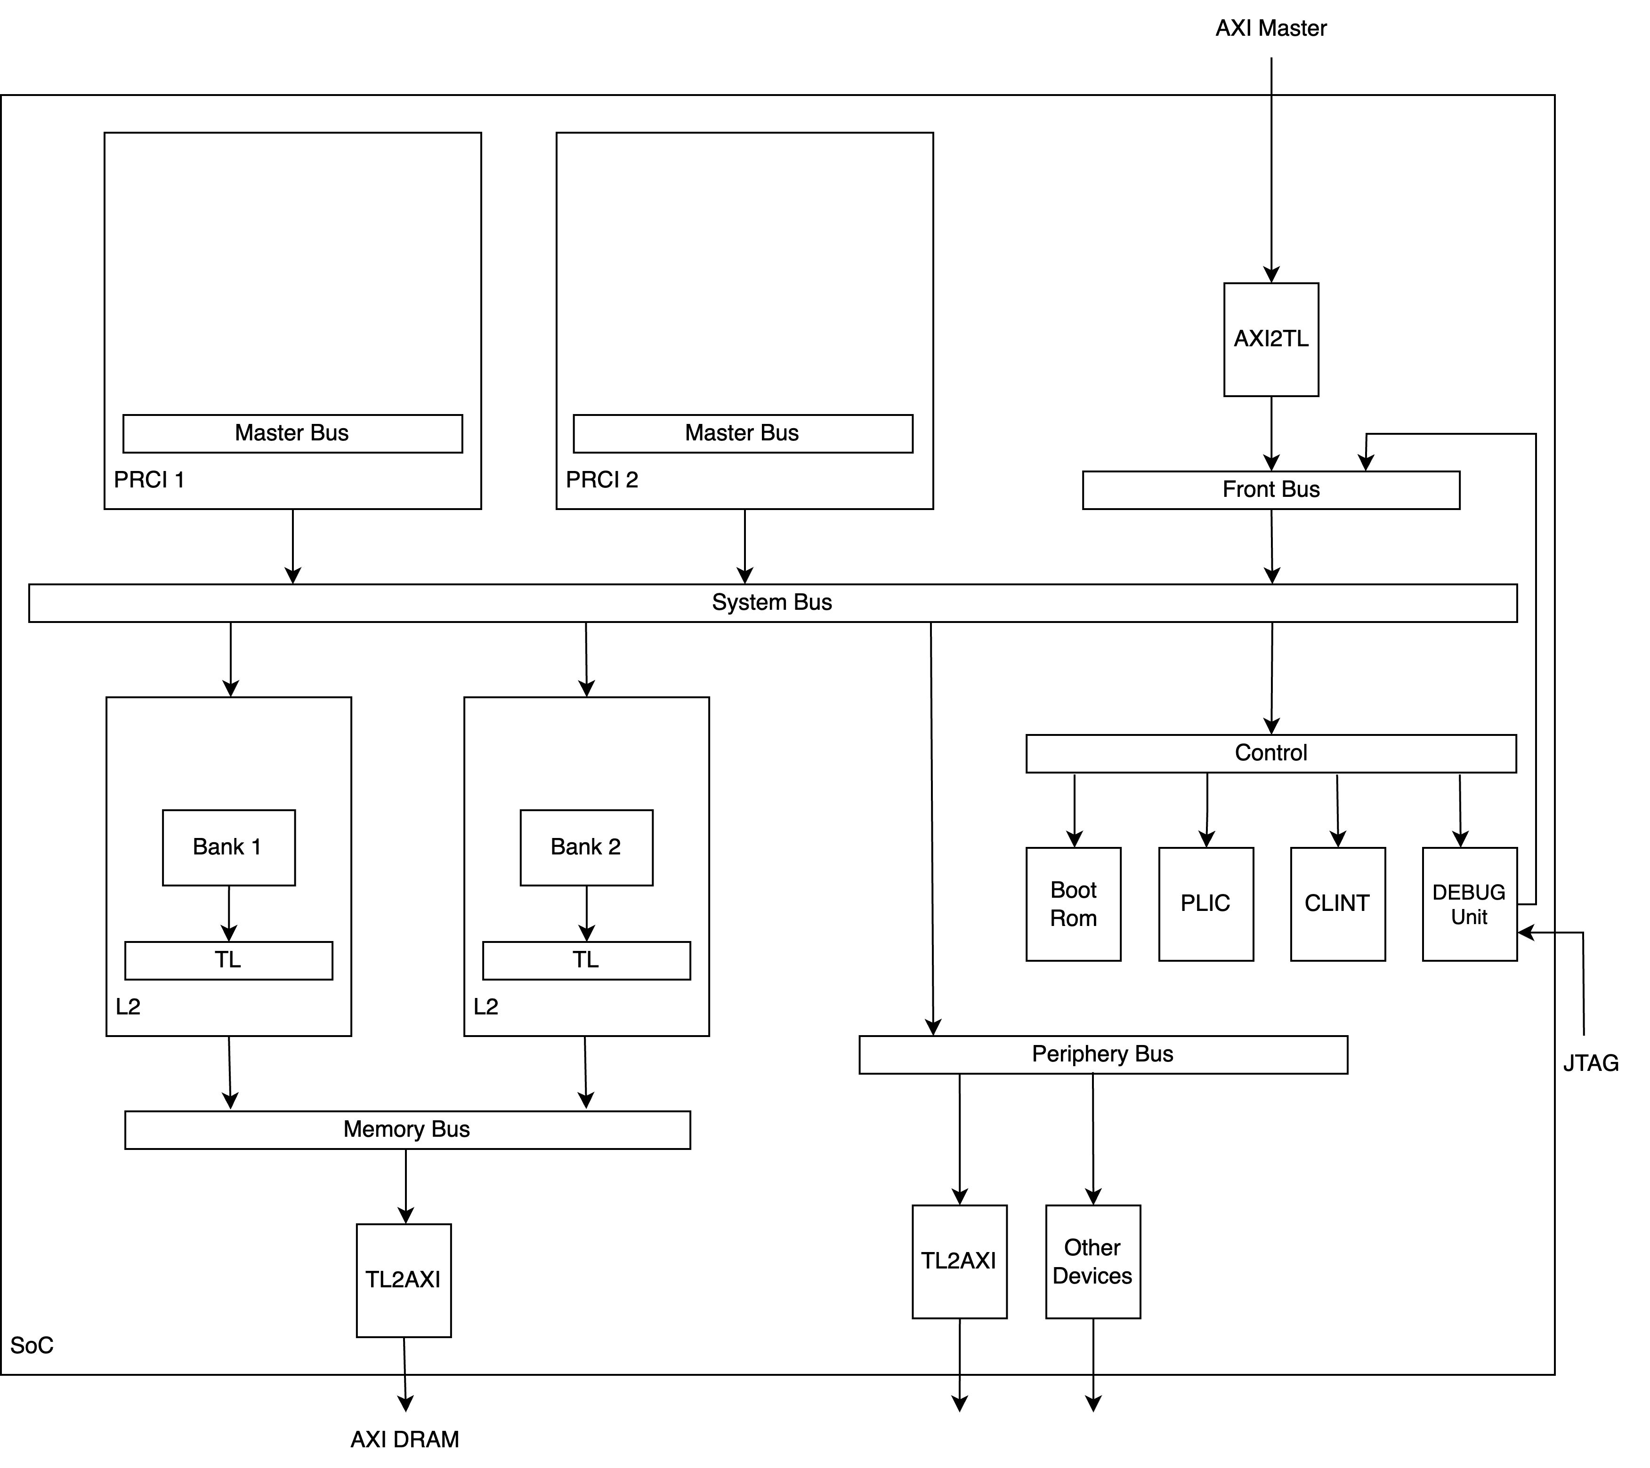
Extending RISC-V Keystone To Include Efficient Secure Memory
Extending RISC-V
RocketChip SoC
Building Secure Memory
FPGA
Extra dimension
Notes:
GIVE A BRIEF OVERVIEW
The reason why are doing this
We are building sevure memory using FPA, and boy did I know what I got myself involved in. And a lot of the paper implementation depended. Some things go matter cant cant be ignored such as in the case of siulations.

Slide 17
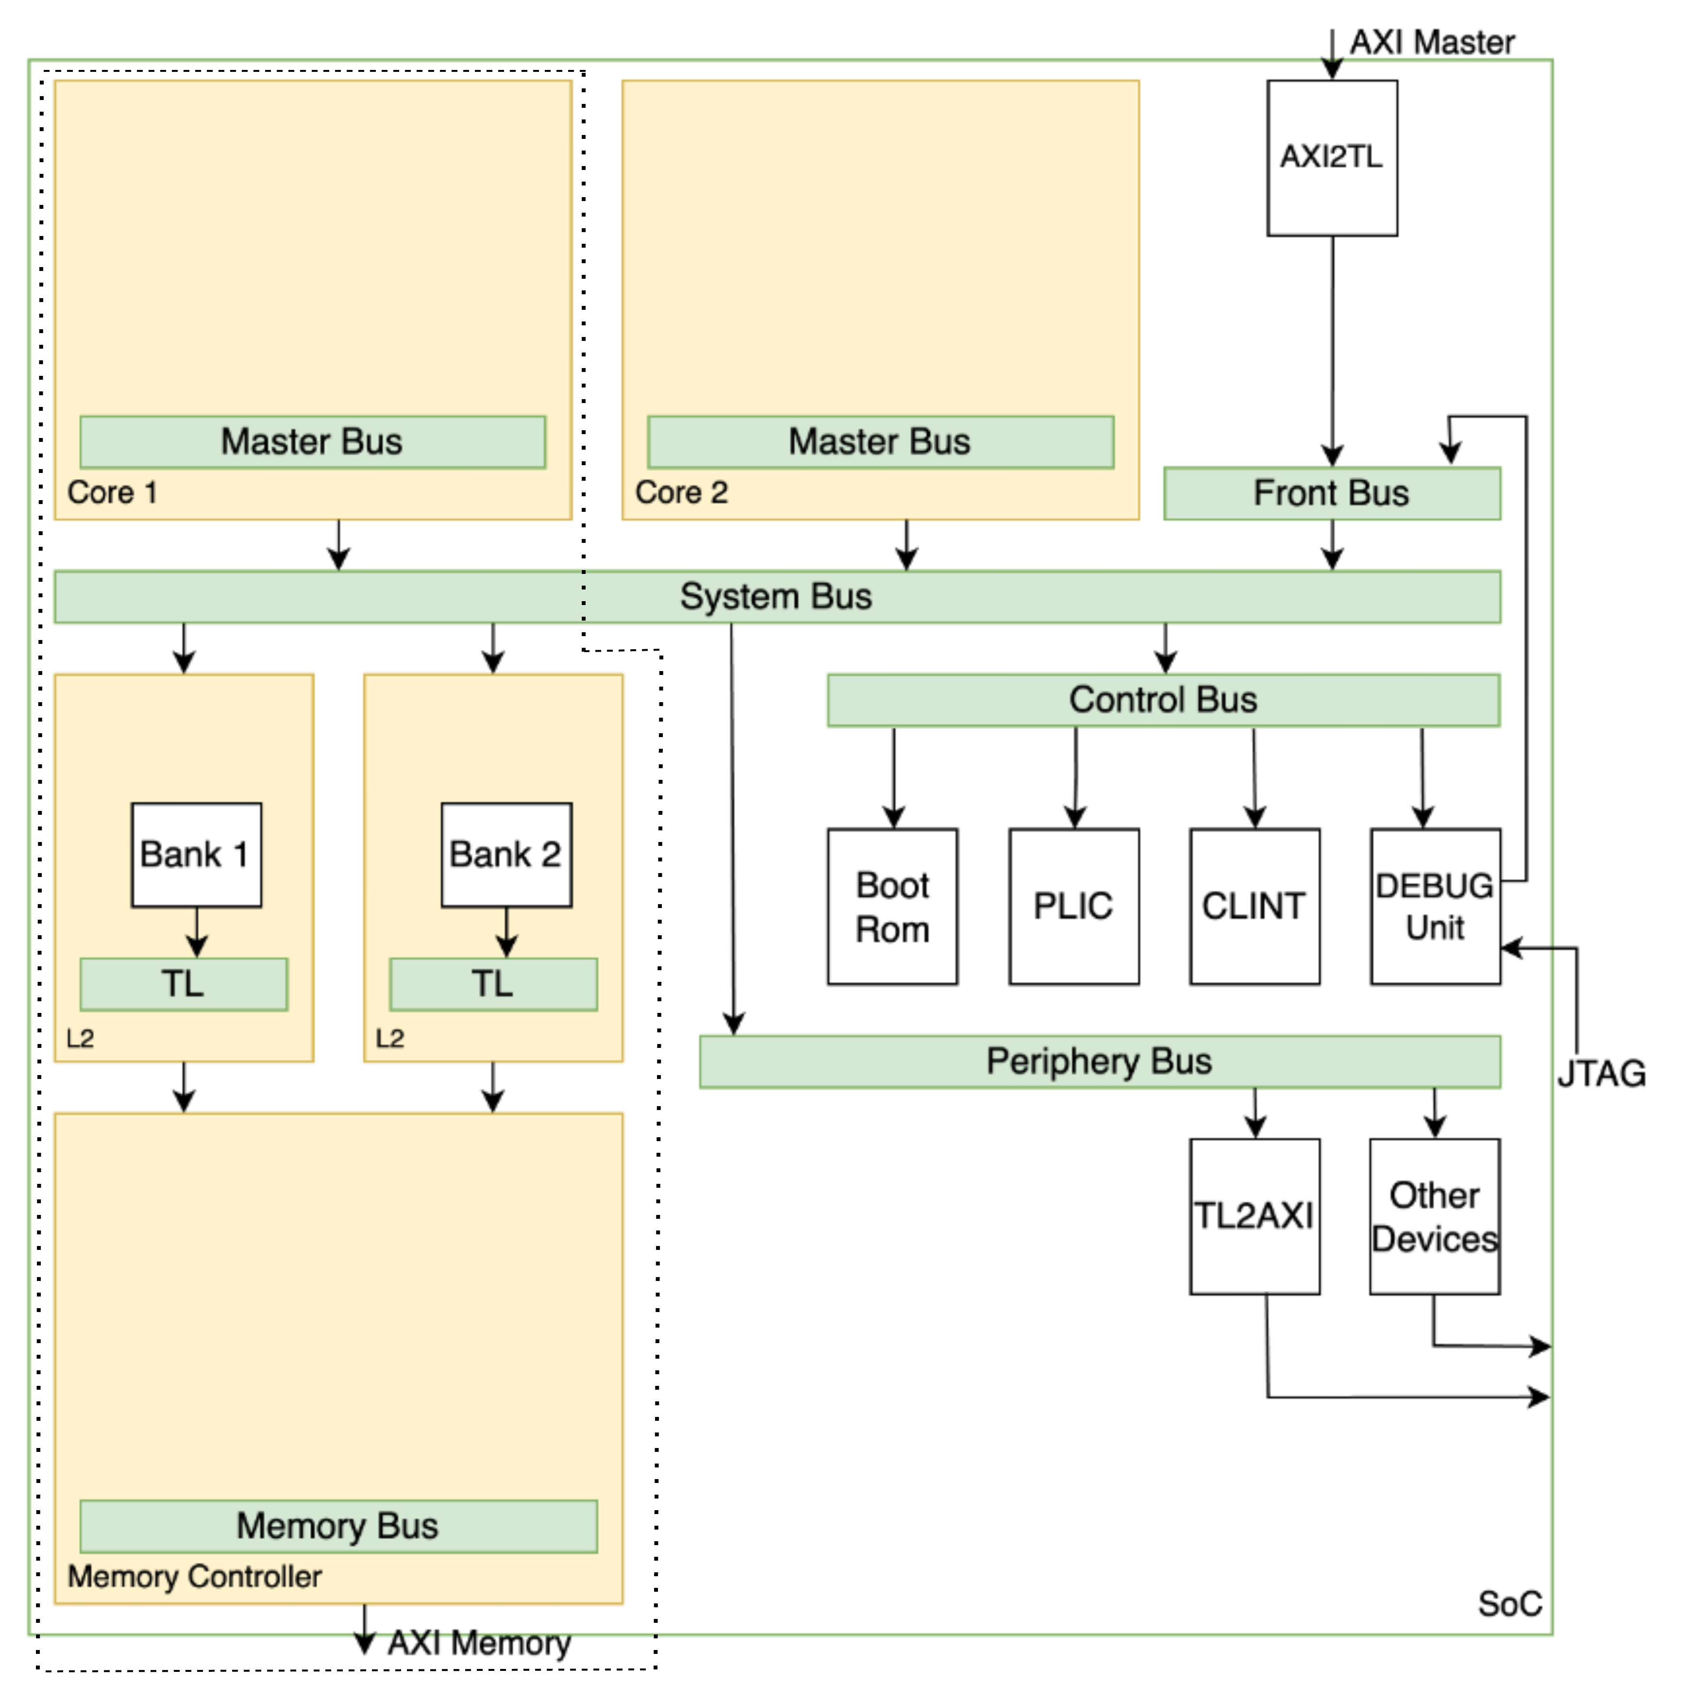
Extending RISC-V Keystone To Include Efficient Secure Memory
Extending RISC-V
RocketChip SoC
Building Secure Memory
FPGA
Extra dimension
Notes:
GIVE A BRIEF OVERVIEW
The reason why are doing this
We are building sevure memory using FPA, and boy did I know what I got myself involved in. And a lot of the paper implementation depended. Some things go matter cant cant be ignored such as in the case of siulations.

Slide 18
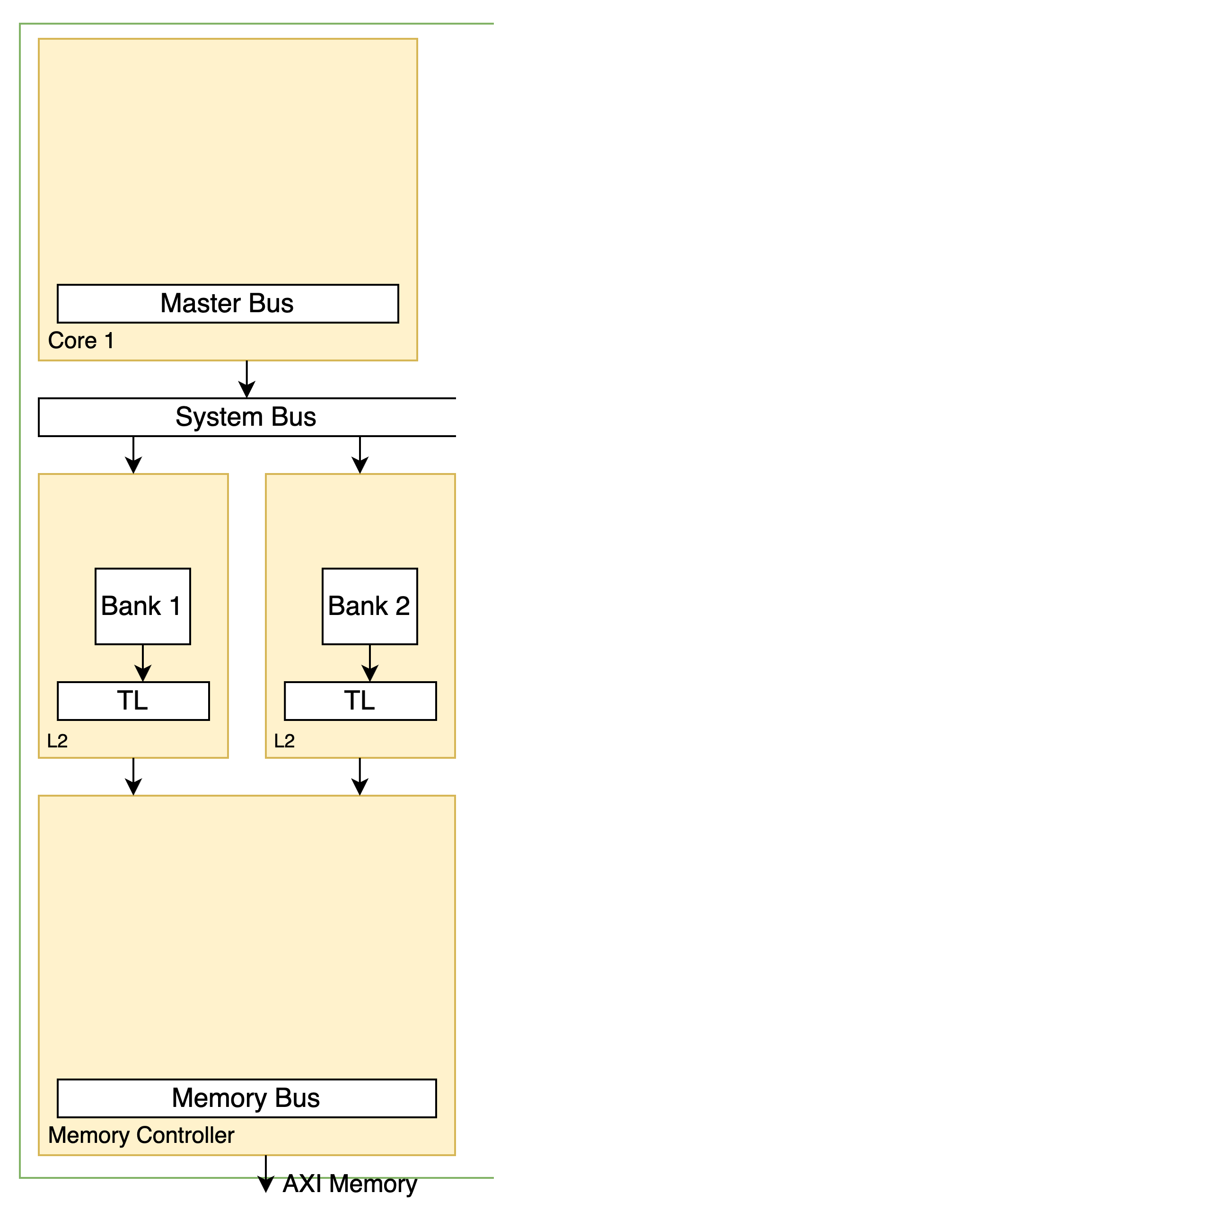
Extending RISC-V Keystone To Include Efficient Secure Memory
Extending SoC
Confidentiality
Memory Controller (MC)
Enable Encryption (ee)
PMPChecker
TileLink (TL)
Encryption Engine(EE)
Critical Path

Slide 19
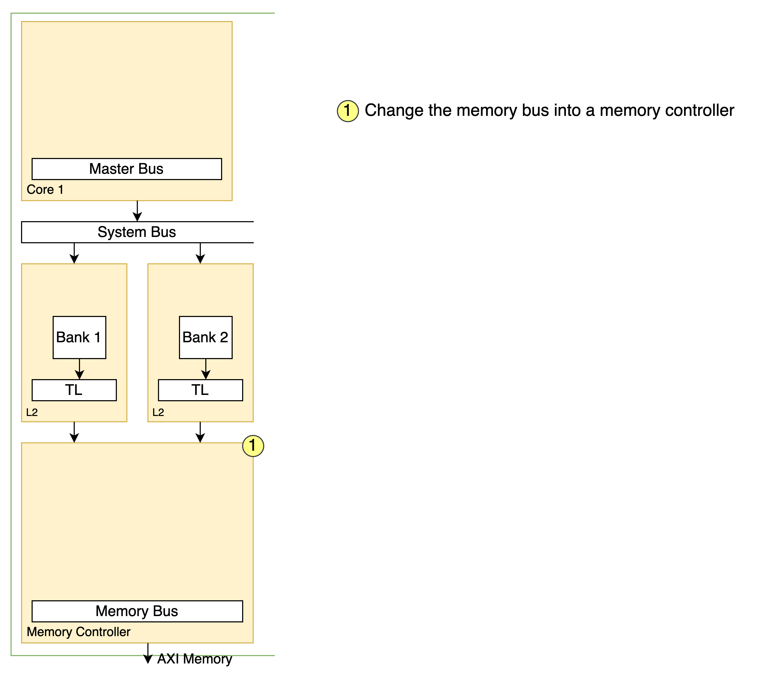
Extending RISC-V Keystone To Include Efficient Secure Memory
Extending SoC
Confidentiality
Memory Controller (MC)
Enable Encryption (ee)
PMPChecker
TileLink (TL)
Encryption Engine(EE)
Critical Path

Slide 20
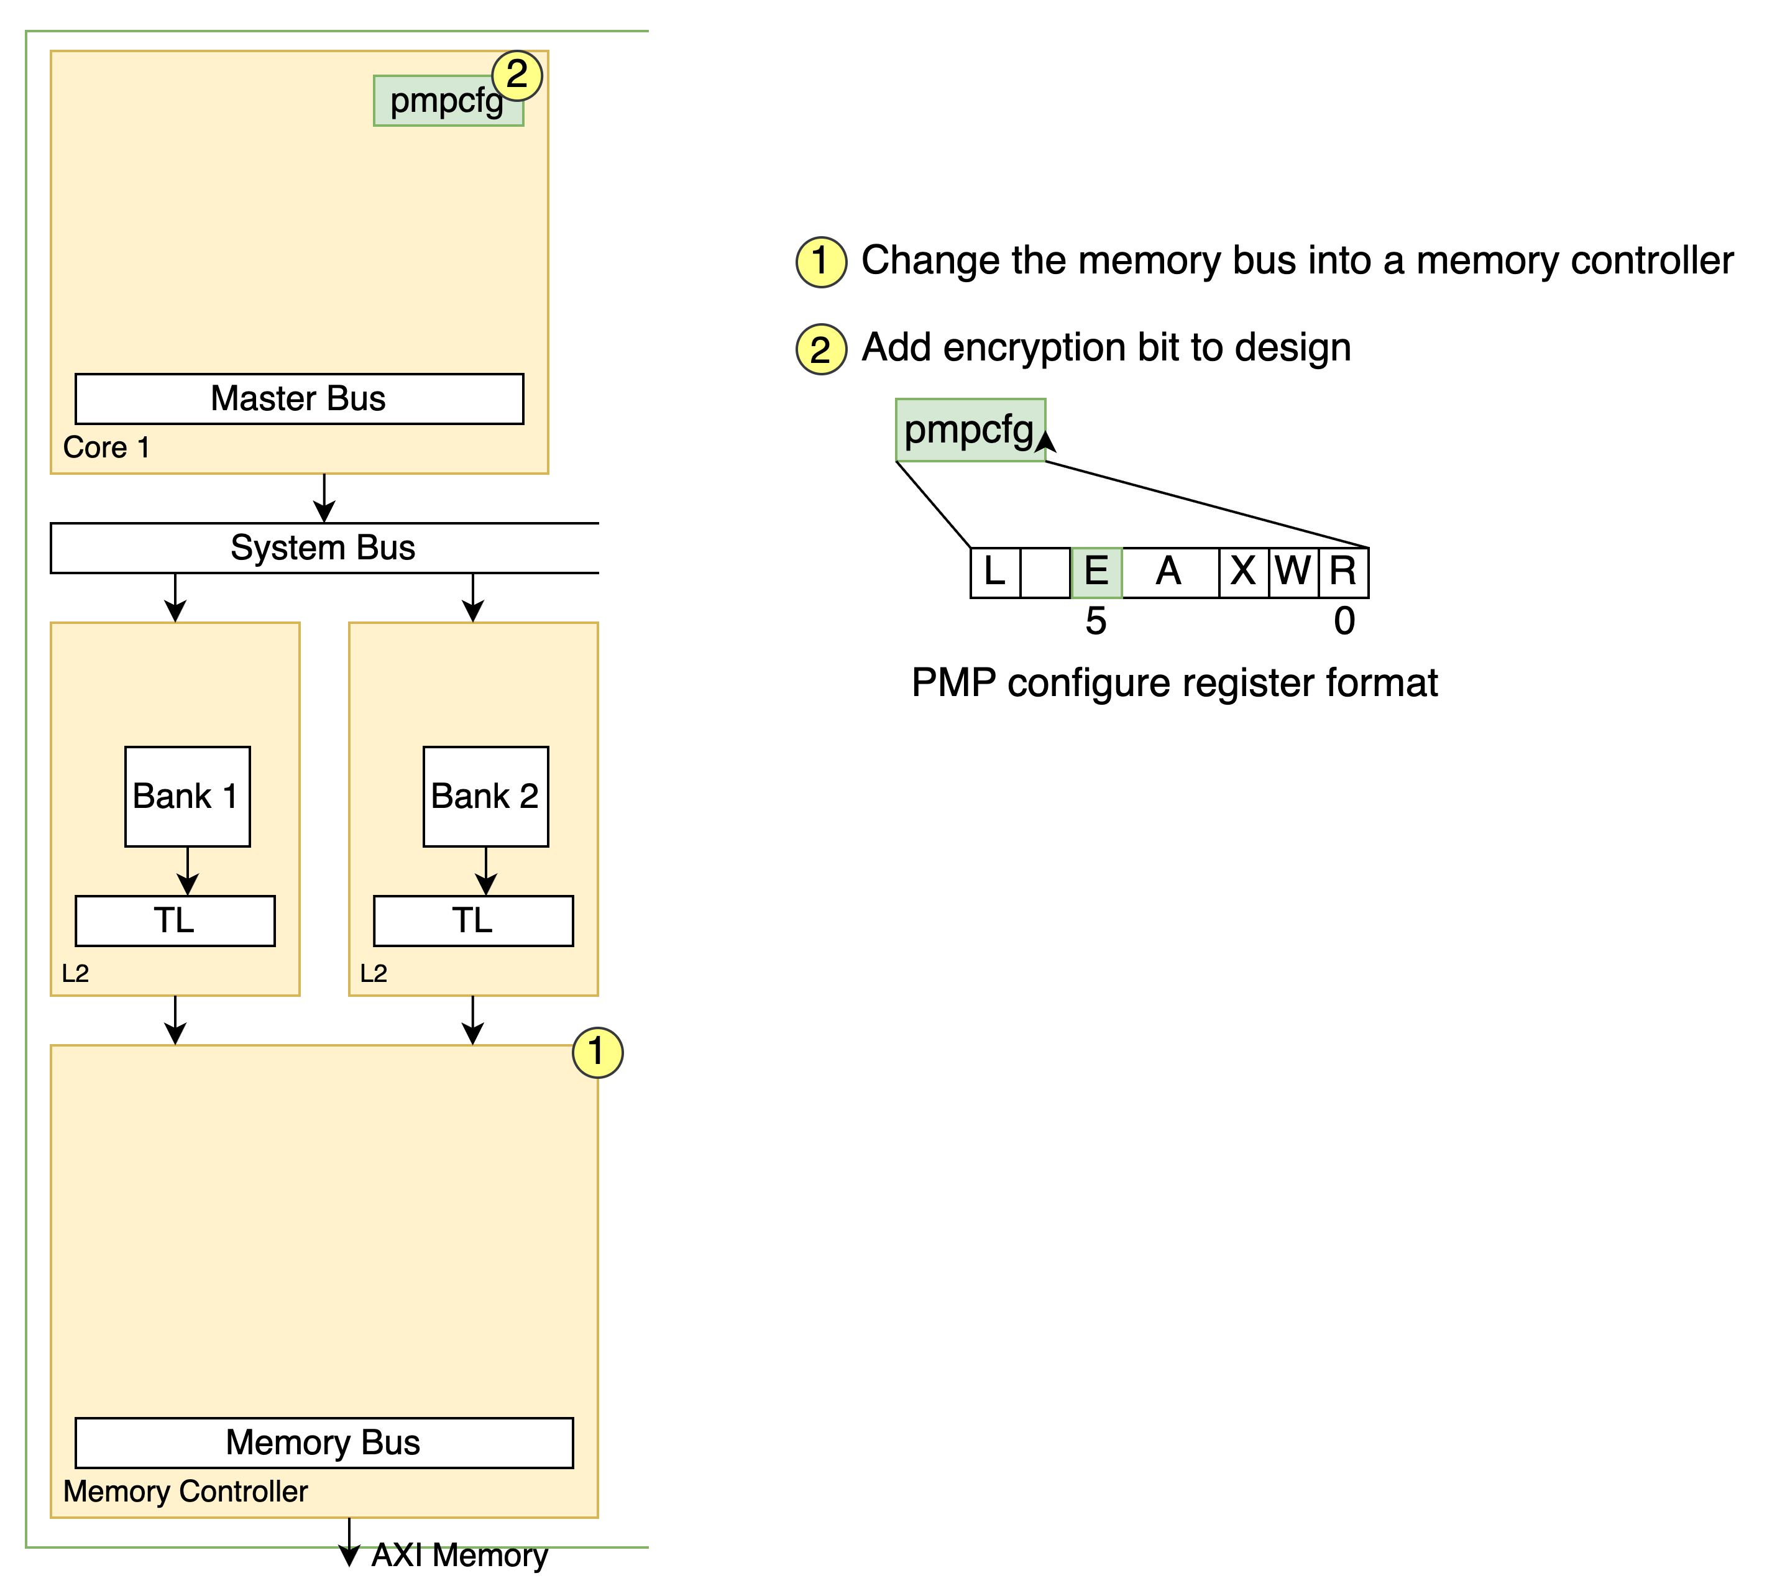
Extending RISC-V Keystone To Include Efficient Secure Memory
Extending SoC
Confidentiality
Memory Controller (MC)
Enable Encryption (ee)
PMPChecker
TileLink (TL)
Encryption Engine(EE)
Critical Path

Slide 21
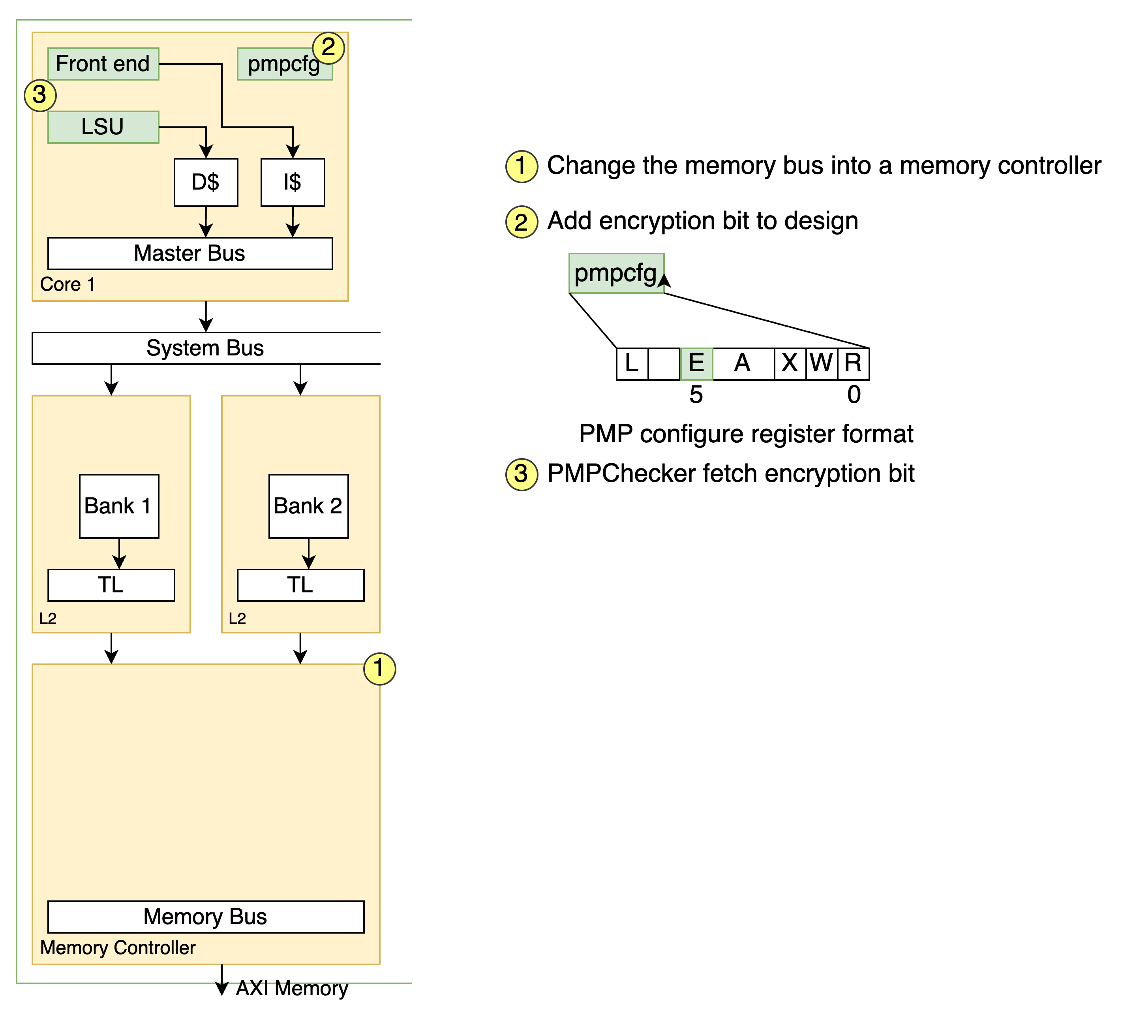
Extending RISC-V Keystone To Include Efficient Secure Memory
Extending SoC
Confidentiality
Memory Controller (MC)
Enable Encryption (ee)
PMPChecker
TileLink (TL)
Encryption Engine(EE)
Critical Path

Slide 22
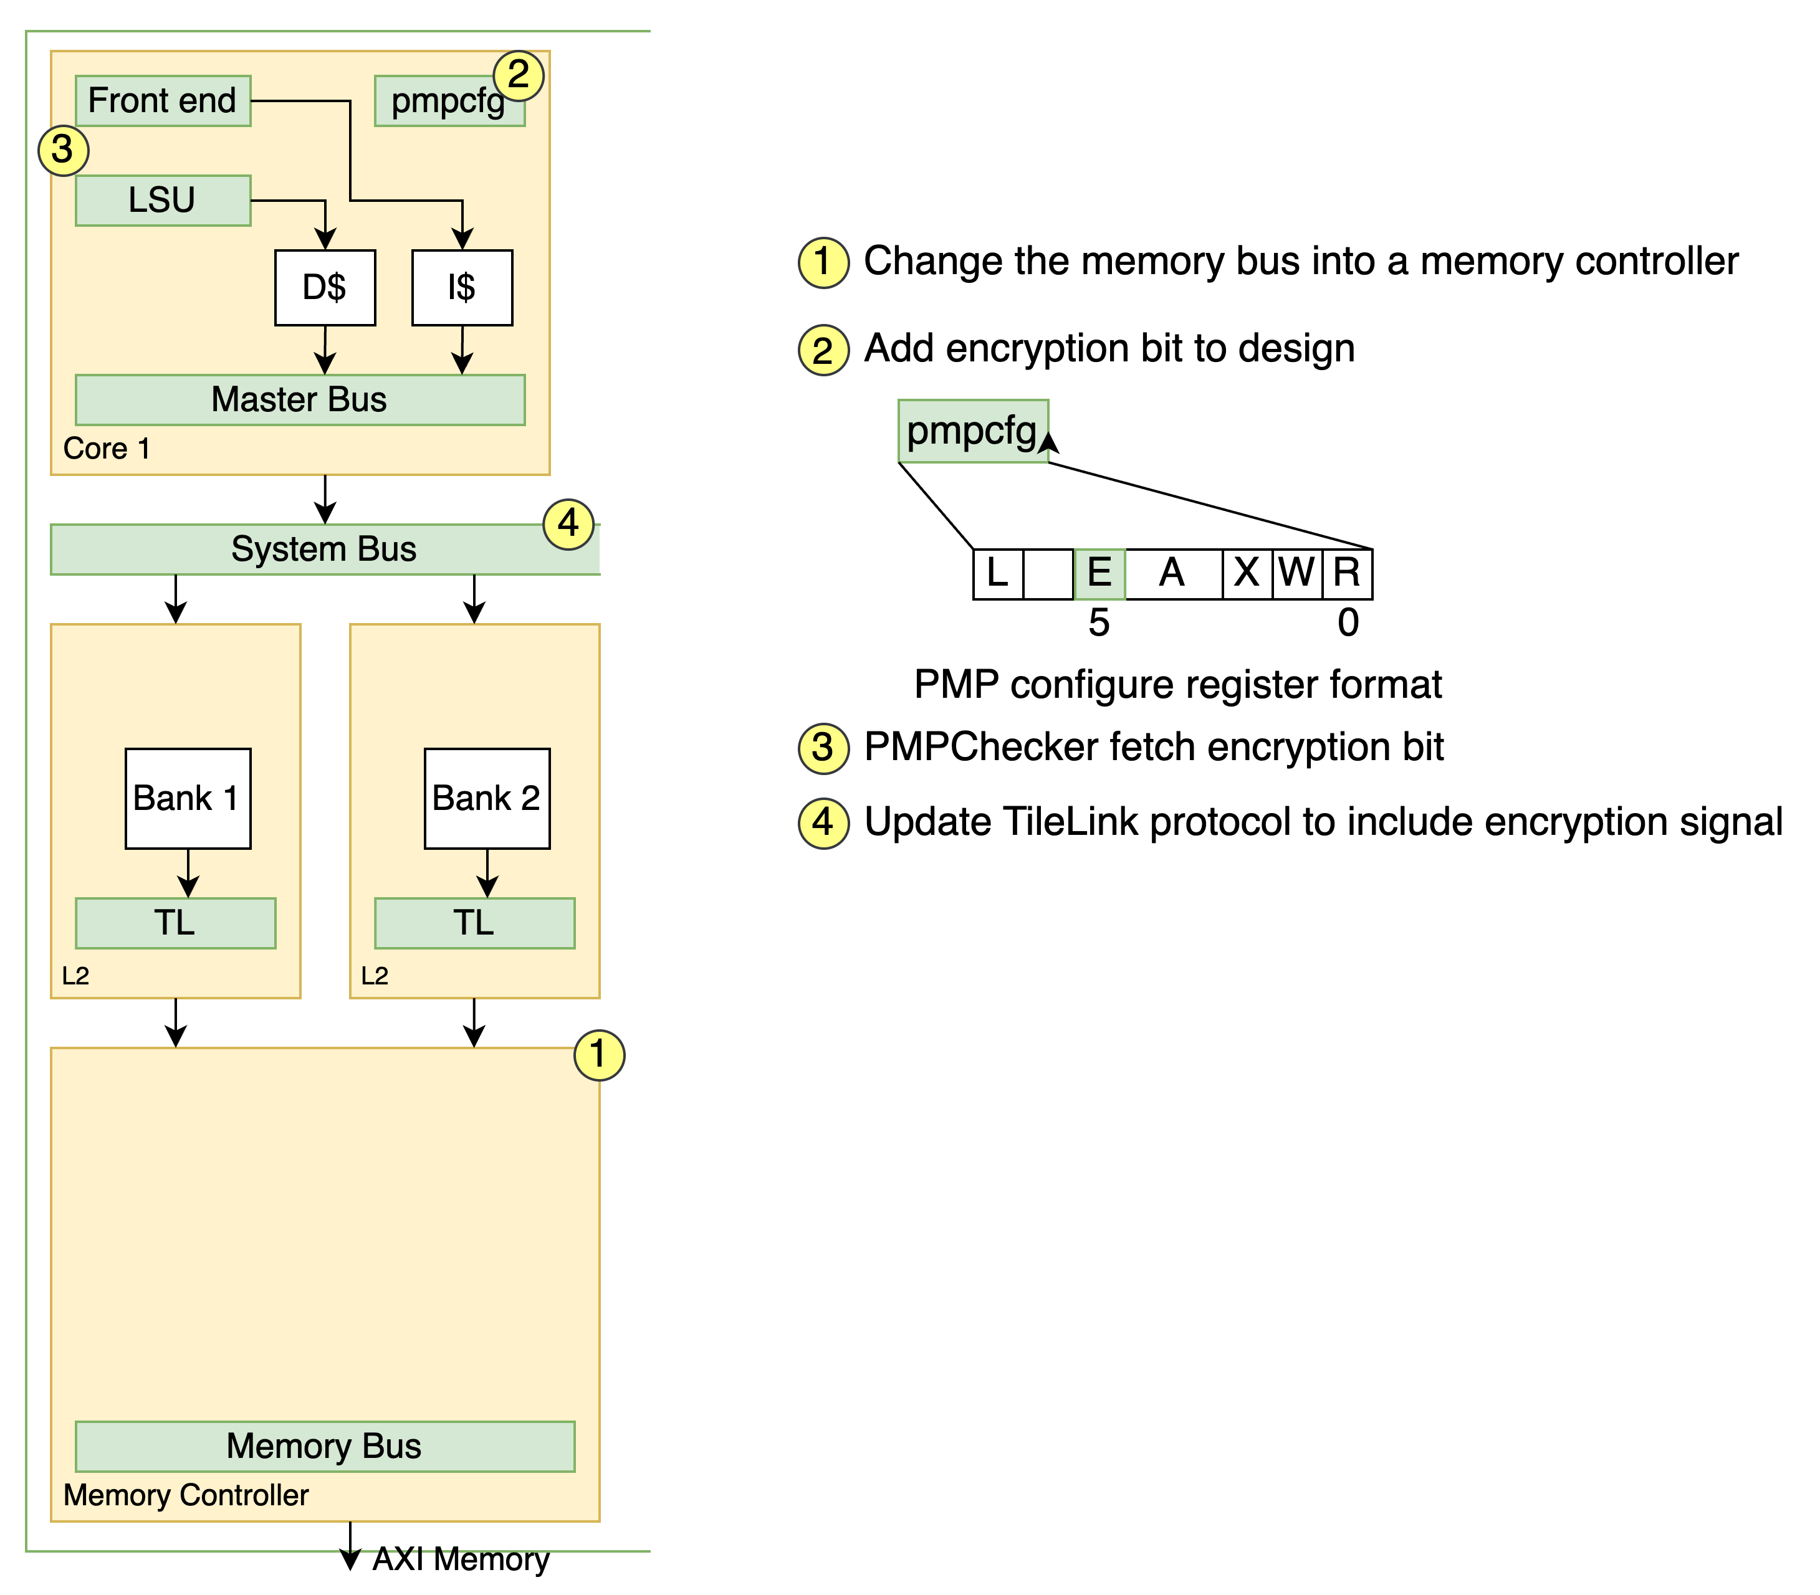
Extending RISC-V Keystone To Include Efficient Secure Memory
Extending SoC
Confidentiality
Memory Controller (MC)
Enable Encryption (ee)
PMPChecker
TileLink (TL)
Encryption Engine(EE)
Critical Path

Slide 23
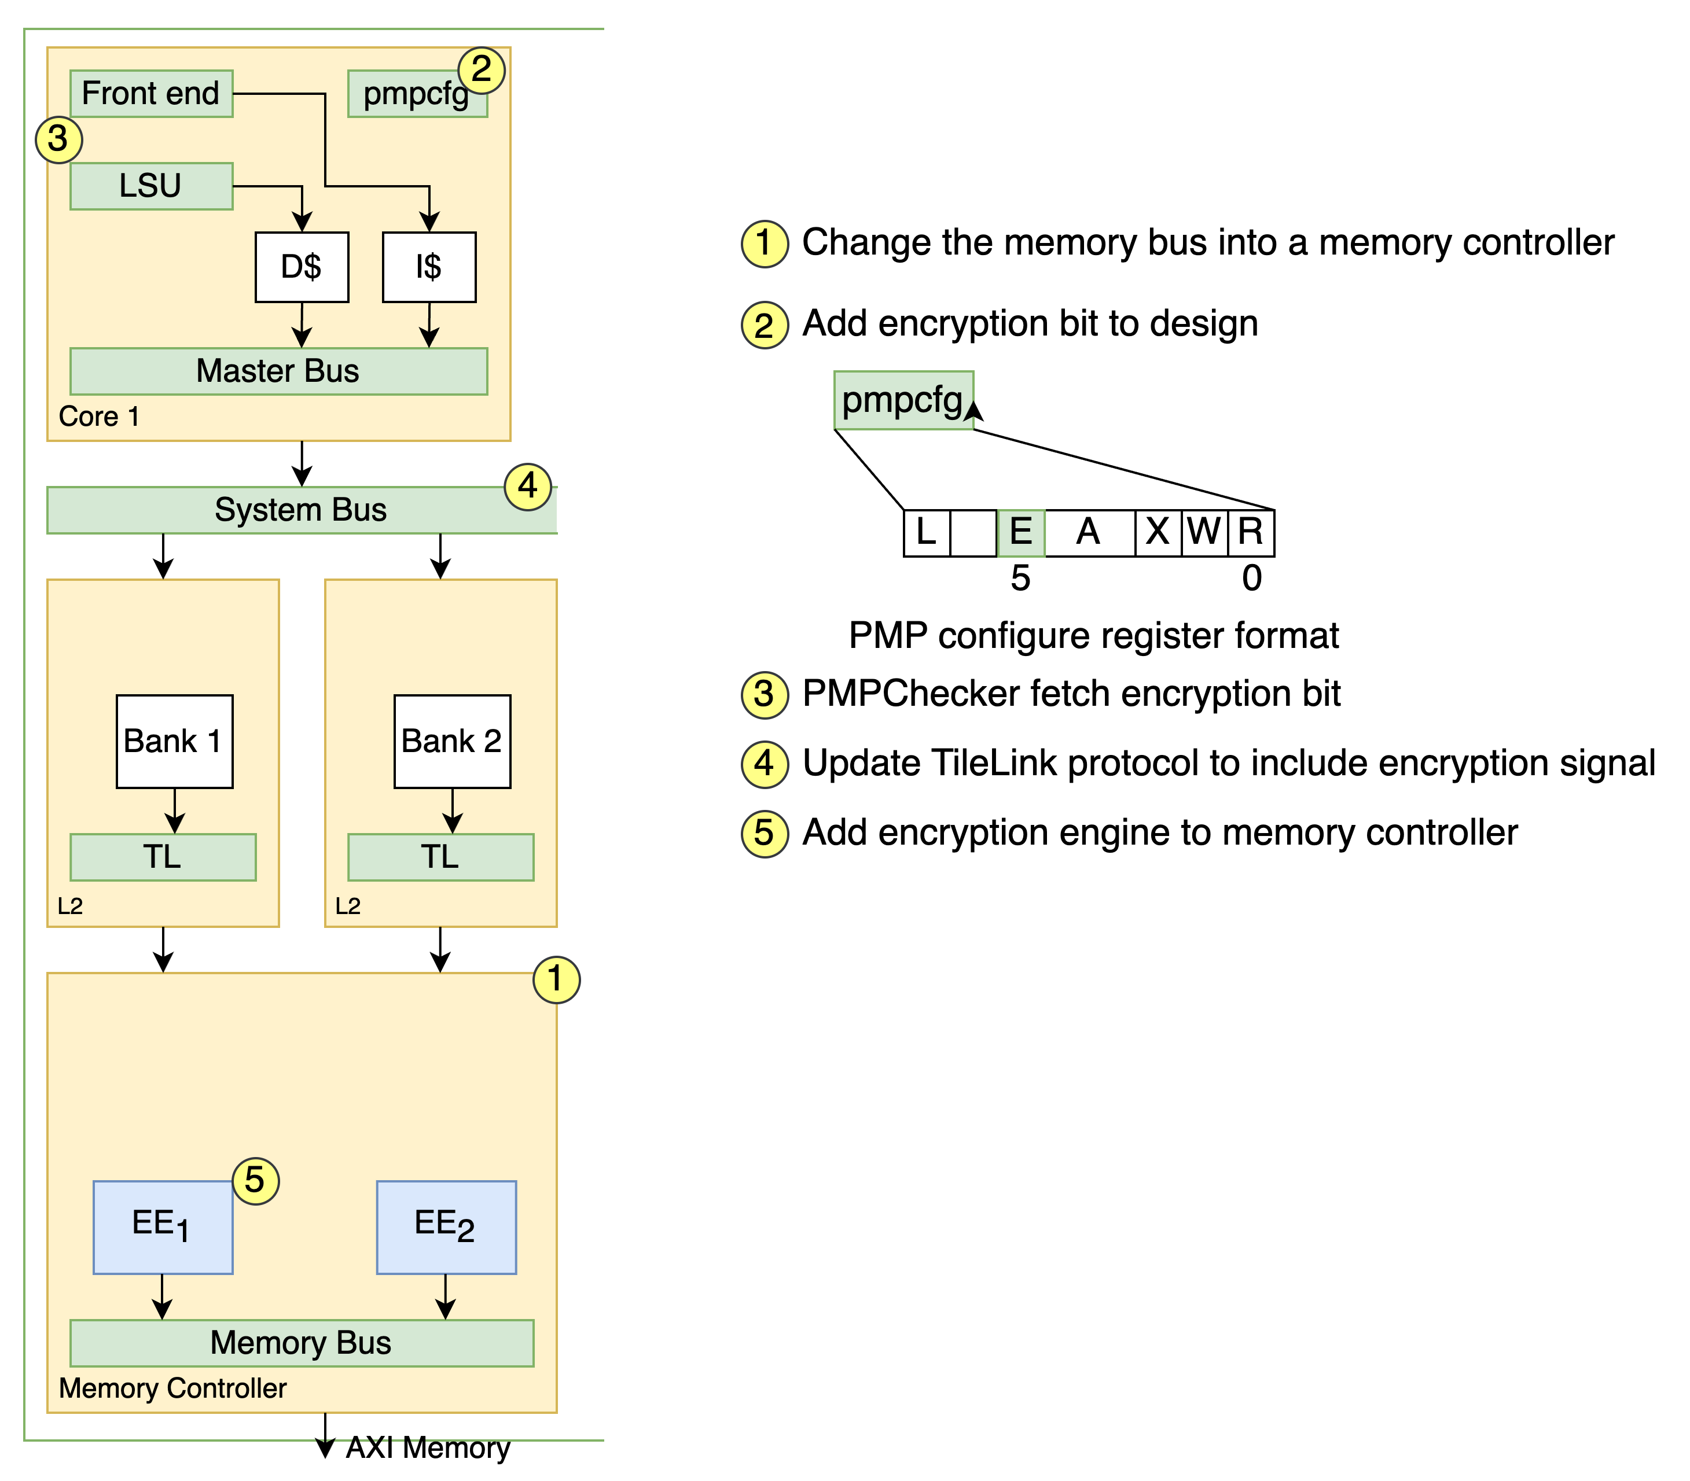
Extending RISC-V Keystone To Include Efficient Secure Memory
Extending SoC
Confidentiality
Memory Controller (MC)
Enable Encryption (ee)
PMPChecker
TileLink (TL)
Encryption Engine(EE)
Critical Path

Slide 24

Extending RISC-V Keystone To Include Efficient Secure Memory
Extending SoC
Confidentiality
Memory Controller (MC)
Enable Encryption (ee)
PMPChecker
TileLink (TL)
Encryption Engine(EE)
Critical Path

Slide 25
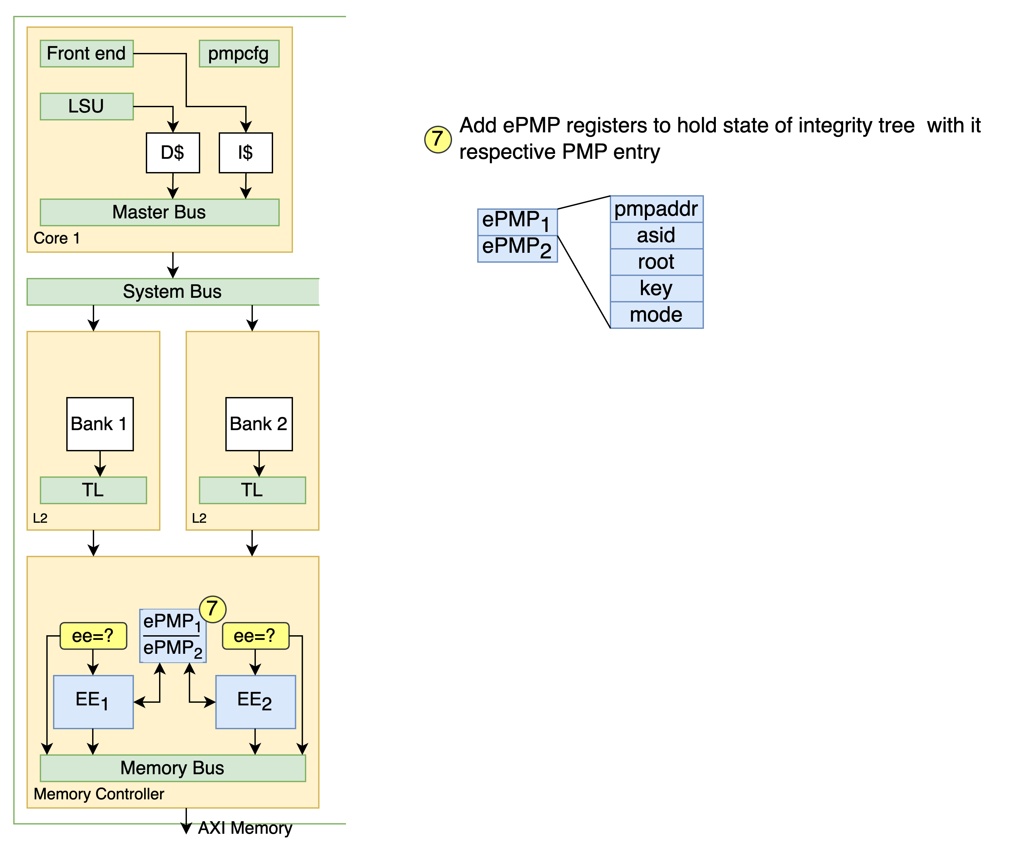
Extending RISC-V Keystone To Include Efficient Secure Memory
Extending SoC
Integrity

Slide 26
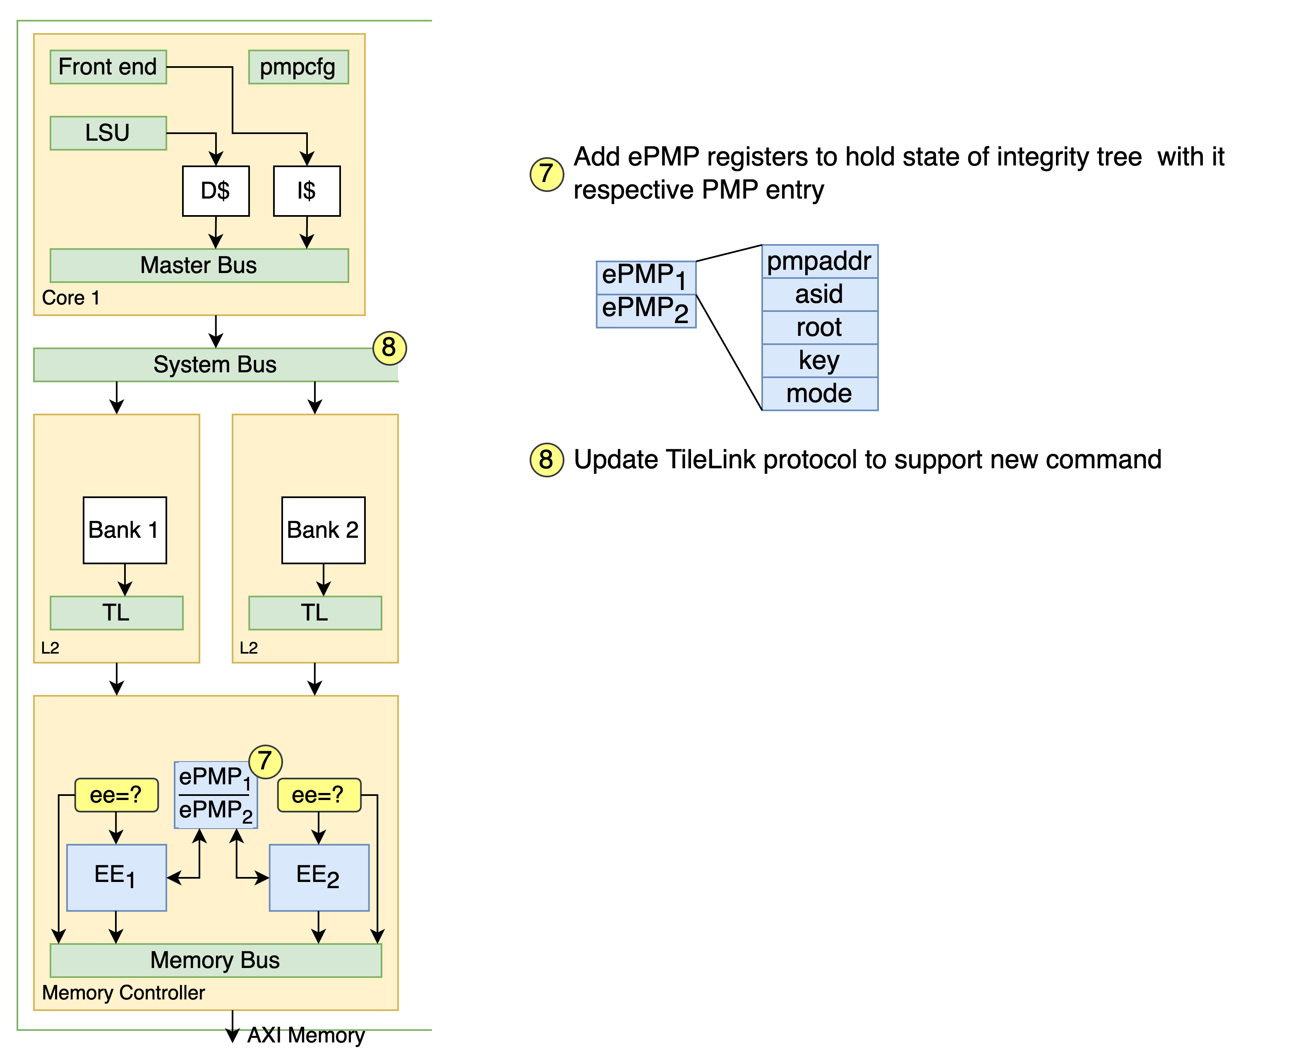
Extending RISC-V Keystone To Include Efficient Secure Memory
Extending SoC
Integrity

Slide 27
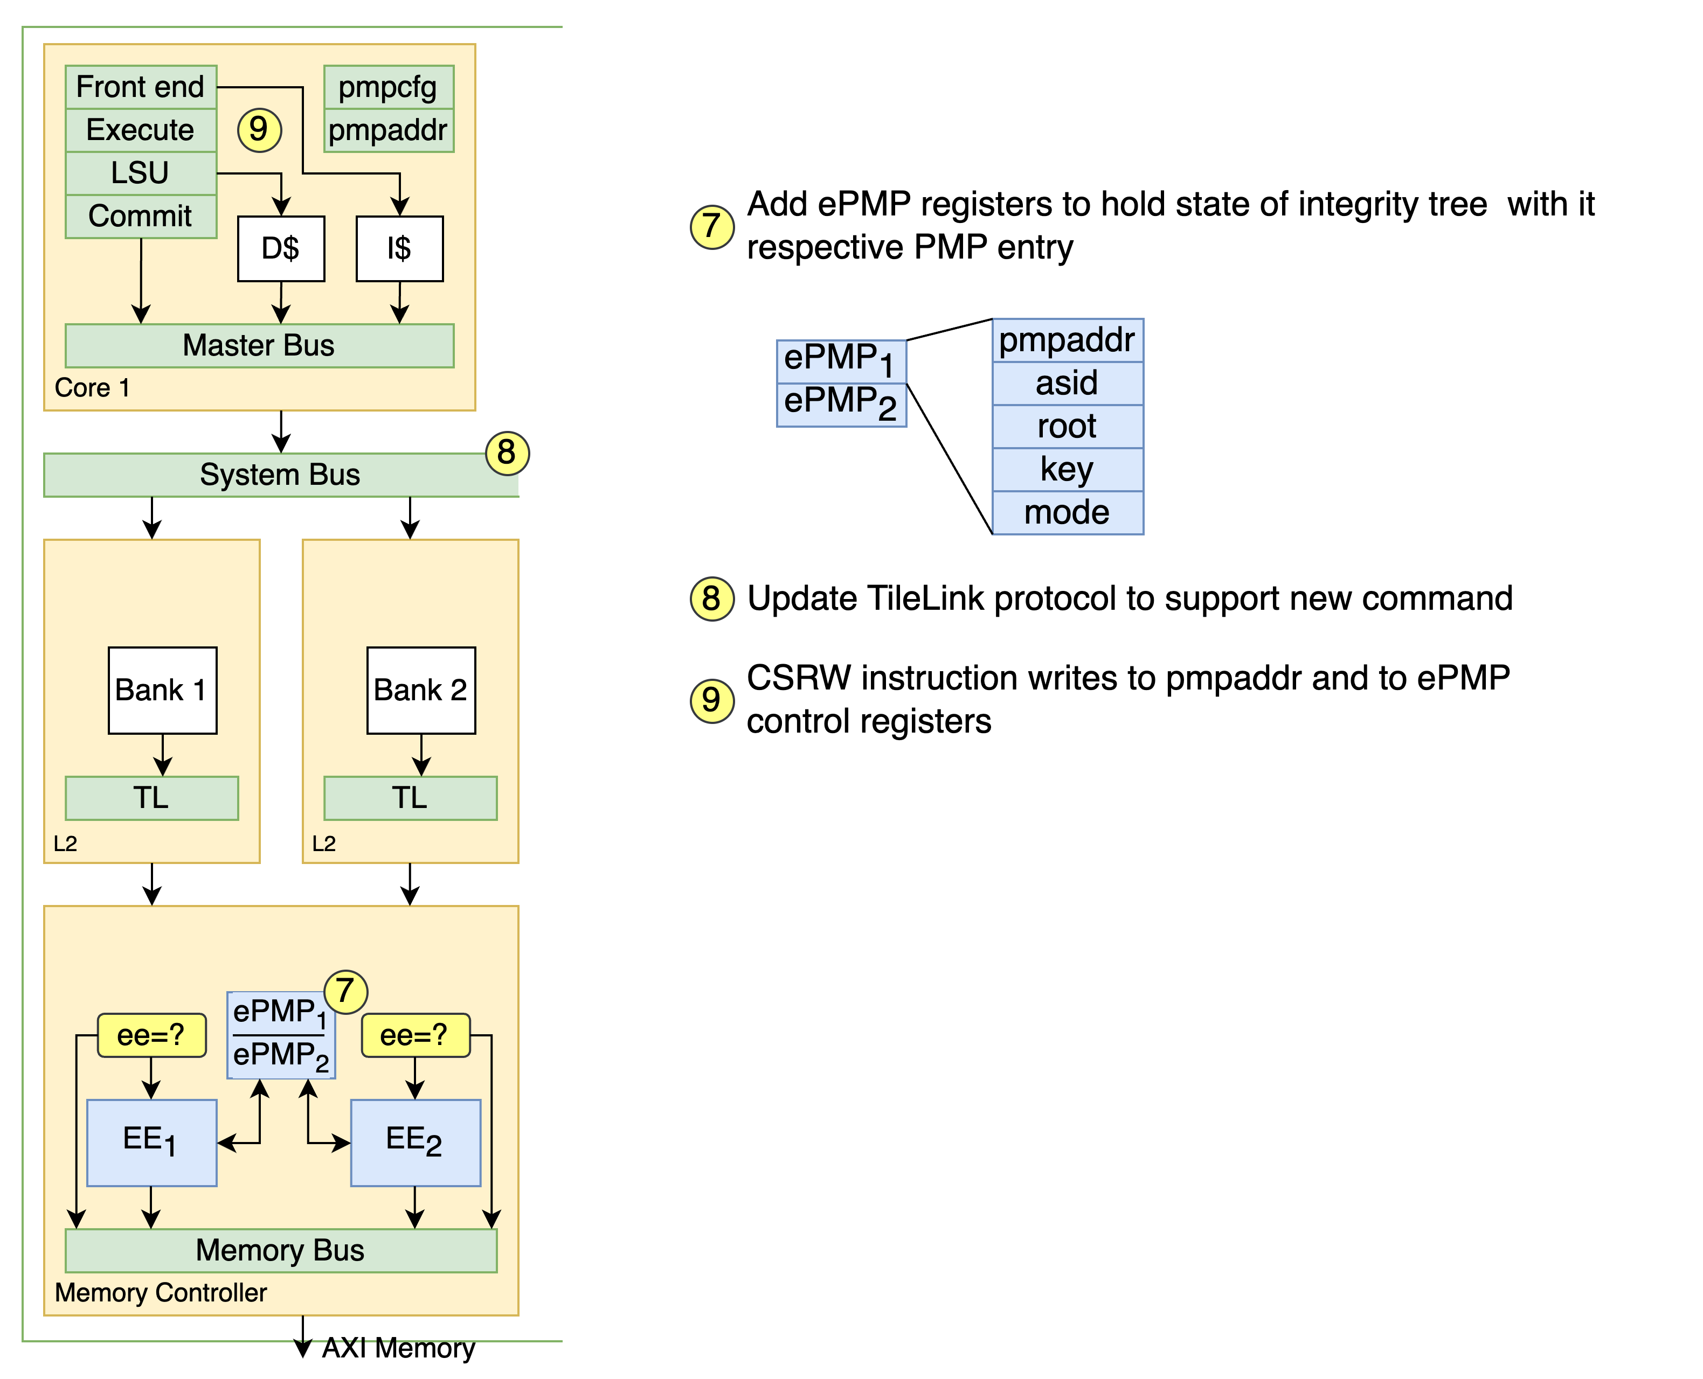
Extending RISC-V Keystone To Include Efficient Secure Memory
Extending SoC
Integrity

Slide 28
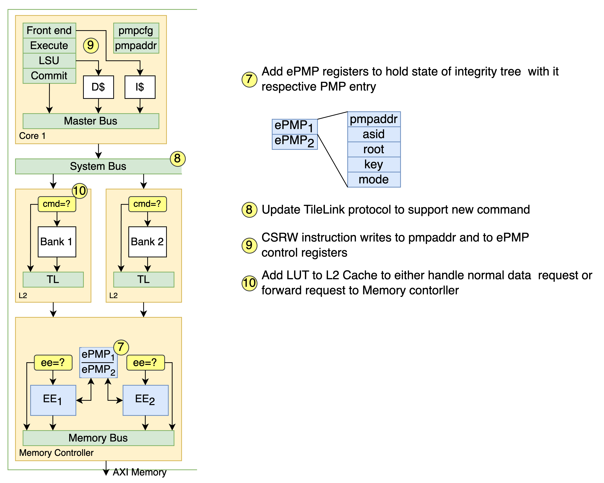
Extending RISC-V Keystone To Include Efficient Secure Memory
Extending SoC
Integrity

Slide 29
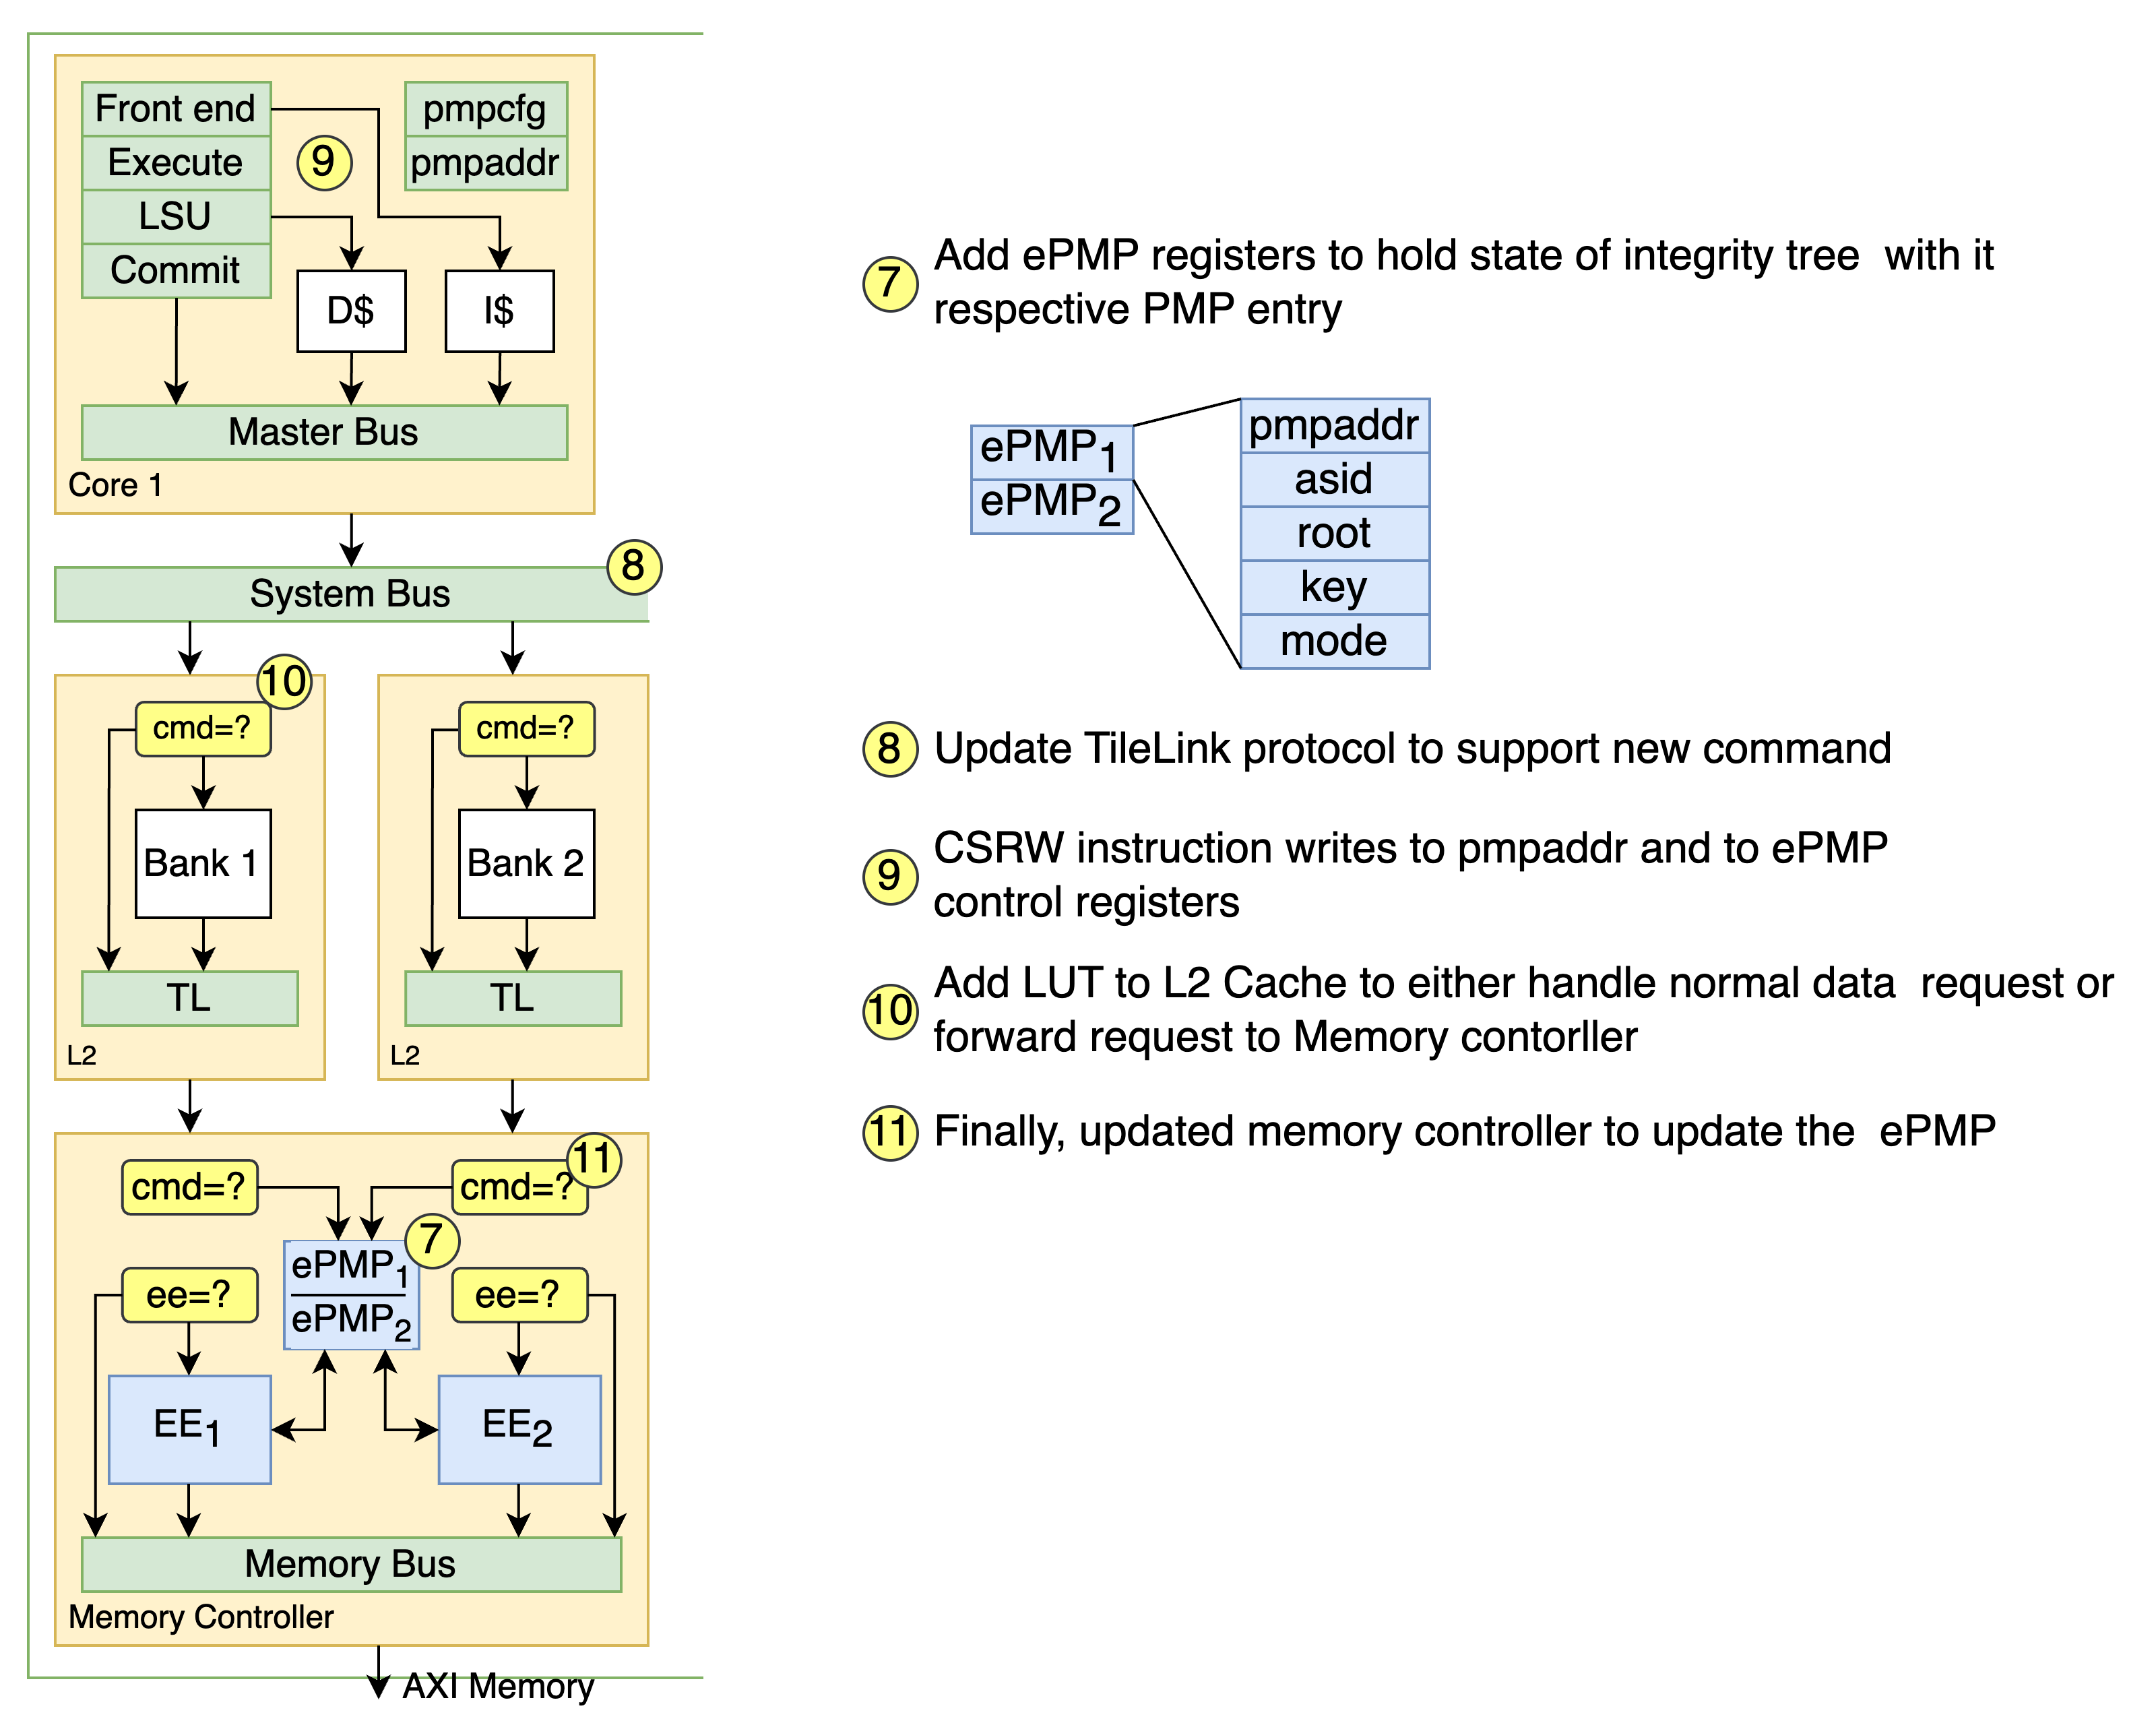
Extending RISC-V Keystone To Include Efficient Secure Memory
Extending SoC
Integrity

Slide 30
Extending RISC-V Keystone To Include Efficient Secure Memory
Secure Memory Example
On Reset - ZSBL will load Keystone secure SM
SM will configure pmpaddr and pmpcfg
Modified Keystone that all enclave will set encryption bit
On CSRW pmpaddr_{x}
the execute stage will buffer address
the commit stage request is sent to MC
On Write - Load Store Unit(LSU) will invoke the PMPChecker
Write is requested
Assume write-though caches for this example
Data is encrypted and integrity tree is updated
Up to this point data is plain text state?
Encrypted data is sent to external memory

Slide 31
Extending RISC-V Keystone To Include Efficient Secure Memory
Continuing our Work
Complete our FPGA implementation
Efficiency
Utilizing existing RISC-V primitives
Expanding on Keystone
Critical path has minimal changes

Slide 32
END OF SLIDES

Slide 33
Bob
GHOST
Sim Swapping
Personas
Activity shaping
SIM_{A}
SIM_{B}
Alice
SIM_{A}
SIM_{B}
Alice
Bob
Notes:
GHOST have many features such as Sim swapping, Personnas, Injection
Here I only illustrate one feature
----- NOT USED
U.S. organizations wish to use indigenous 5G networks when operating in other countries
BUT
The 5G network may be operated by a hostile entity
Assume all network activity is observed

Slide 34
GHOST
SIM_{A}
SIM_{B}
Alice
Bob
Sim Swapping
Normal behavior
Observer
GHOST Enabled
Alice
Bob
SIM_{A}
SIM_{B}
Notes:
GHOST have many features such as Sim swapping, Personnas, Injection
Here I only illustrate one feature
----- NOT USED
U.S. organizations wish to use indigenous 5G networks when operating in other countries
BUT
The 5G network may be operated by a hostile entity
Assume all network activity is observed

Slide 35


GHOST
SIM_{B}
SIM_{A}
Bob
Alice
Sim Swapping
Normal behavior
Observer
GHOST Enabled
Alice
Bob
SIM_{A}
SIM_{B}
Notes:
GHOST have many features such as Sim swapping, Personnas, Injection
Here I only illustrate one feature
----- NOT USED
U.S. organizations wish to use indigenous 5G networks when operating in other countries
BUT
The 5G network may be operated by a hostile entity
Assume all network activity is observed

Slide 36
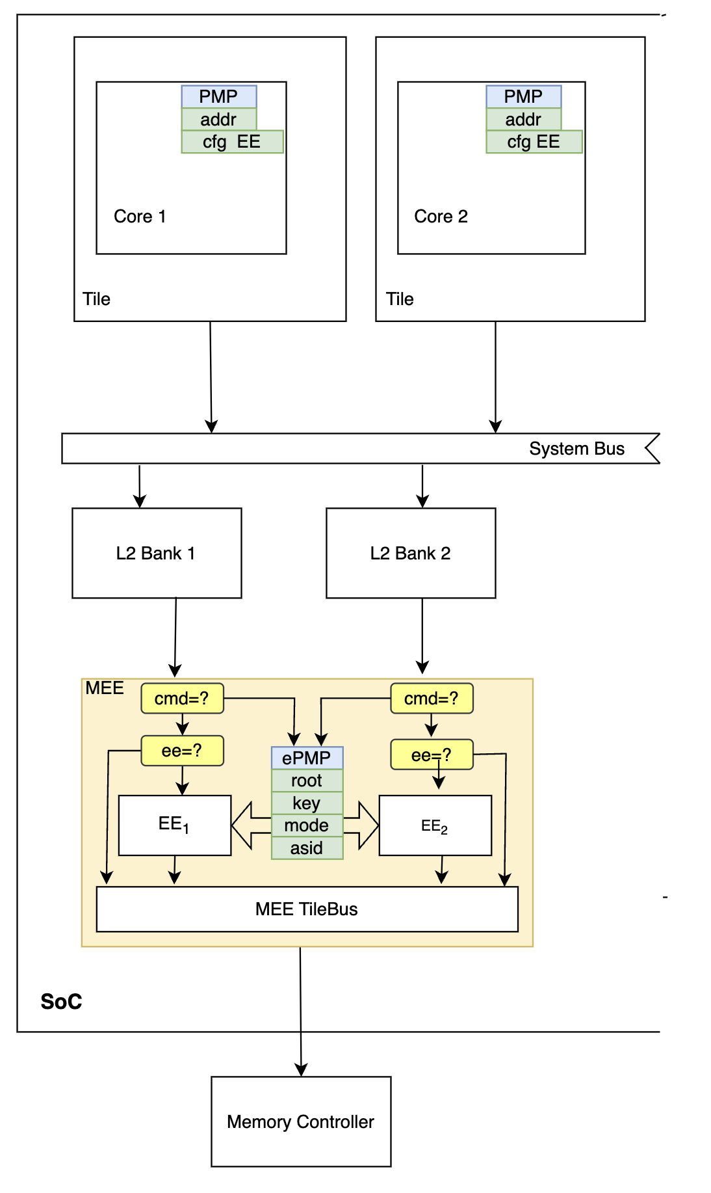
Extending RISC-V Keystone To Include Efficient Secure Memory
Secure Memory Example
Keystone
Pmpcfg
Pmpaddr
Read/Write
PMPChecker
EE

Slide 37
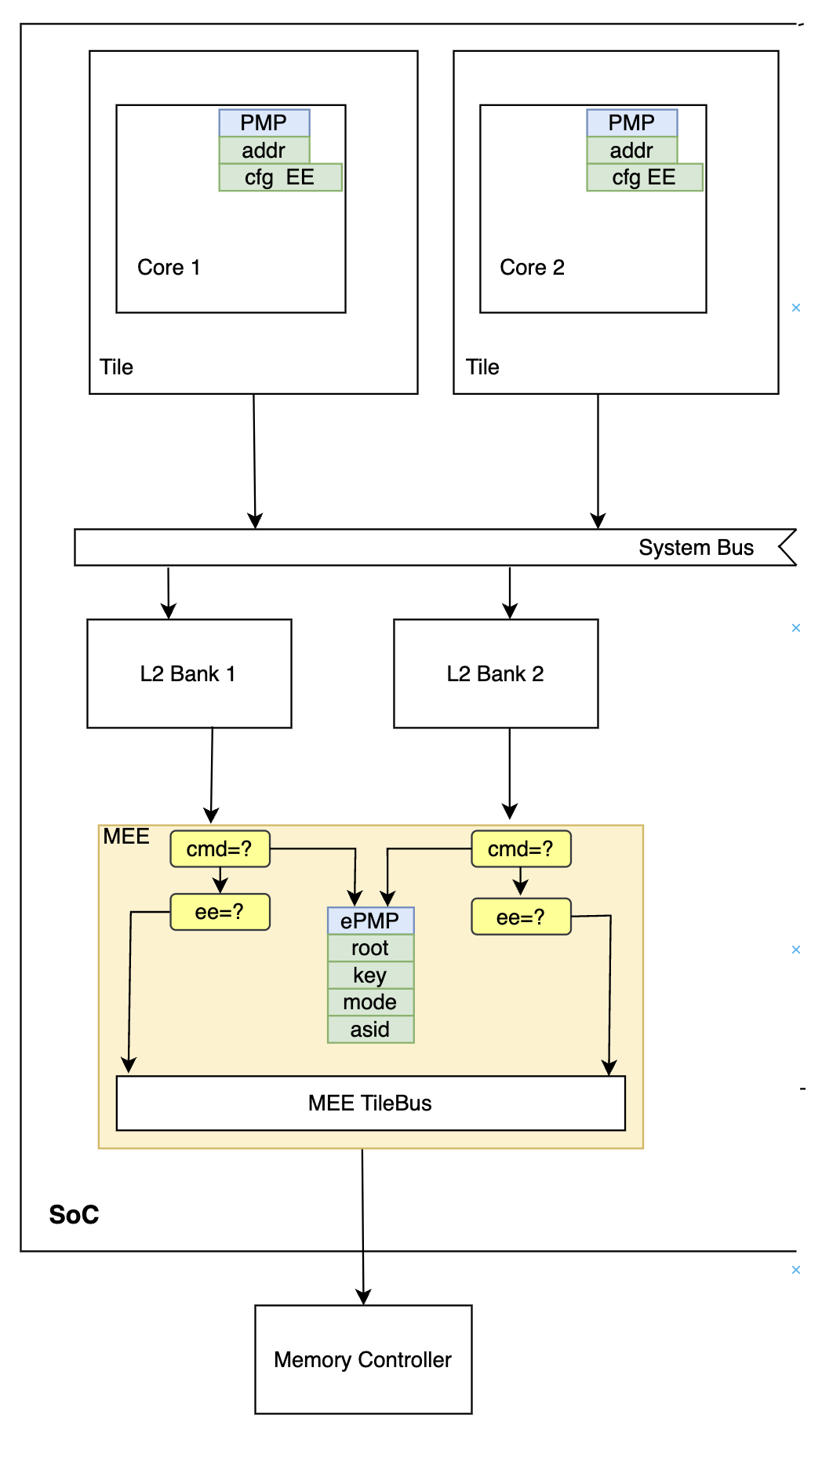
Extending RISC-V Keystone To Include Efficient Secure Memory
RocketChip SoC
Memory Bus
Memory Controller
ePMP
Own CSR Registers
TileLink (TL)
Command to update Memory Controller
Encryption Enabled (EE) Control Signal

Slide 38
Extending RISC-V Keystone To Include Efficient Secure Memory
RocketChip SoC
Memory Bus
Memory Controller
ePMP
Own CSR Registers
TileLink (TL)
Command to update Memory Controller
Encryption Enabled (EE) Control Signal
Cores
Reserved bit 6 pmpcfg_{x}
CSRW pmpaddr_{x}
PMPChecker

Slide 39
Extending RISC-V Keystone To Include Efficient Secure Memory
RocketChip SoC
Memory Bus
Memory Controller
ePMP
Own CSR Registers
TileLink (TL)
Command to update Memory Controller
Encryption Enabled (EE) Control Signal
Cores
Reserved bit 6 pmpcfg_{x}
CSRW pmpaddr_{x}
PMPChecker
Encryption Engine

Slide 40
GHOST
Sim Swapping
Personas
Injection data
Bob
A
B
Alice
A
B
Alice
Bob
Notes:
GHOST has many components and is primary a software solution running on a cell phone and connecting to a 5G Networks. It receive action plans with a C2 node. What happens if the cellphone itself is compromise either remotely or physically.
----- NOT USED
U.S. organizations wish to use indigenous 5G networks when operating in other countries
BUT
The 5G network may be operated by a hostile entity
Assume all network activity is observed

Slide 41
Bob
GHOST
Sim Swapping
Personas
Injection data
A
B
Alice
Bob
B
Alice
Notes:
GHOST has many components and is primary a software solution running on a cell phone and connecting to a 5G Networks. It receive action plans with a C2 node. What happens if the cellphone itself is compromise either remotely or physically.
----- NOT USED
U.S. organizations wish to use indigenous 5G networks when operating in other countries
BUT
The 5G network may be operated by a hostile entity
Assume all network activity is observed

Slide 42
GHOST
Sim Swapping
Personas
Injection data
Bob
Alice
Bob
Alice
Notes:
GHOST has many components and is primary a software solution running on a cell phone and connecting to a 5G Networks. It receive action plans with a C2 node. What happens if the cellphone itself is compromise either remotely or physically.
----- NOT USED
U.S. organizations wish to use indigenous 5G networks when operating in other countries
BUT
The 5G network may be operated by a hostile entity
Assume all network activity is observed

Slide 43
Trusted Execution Environments (TEEs)

Slide 44
Secure Memory

Slide 45
A
B
Alice
Bob

Slide 46
SIM_{A}
SIM_{B}
Alice
Bob
Bob
SIM_{A}
SIM_{B}
Alice

